Slide 1
Inspiring, empowering, and transforming children's
lives through outdoor education.
Notes:
-Exploring New Horizons has been around for 40 years and we have kids come every week of the school year for 4-5 day residential programs.
- You are coming to our Scotts Valley, Redwood Glen site. Students will explore the Redwood forest, creek, and coast.
-Does anyone know when you are coming?

Slide 2
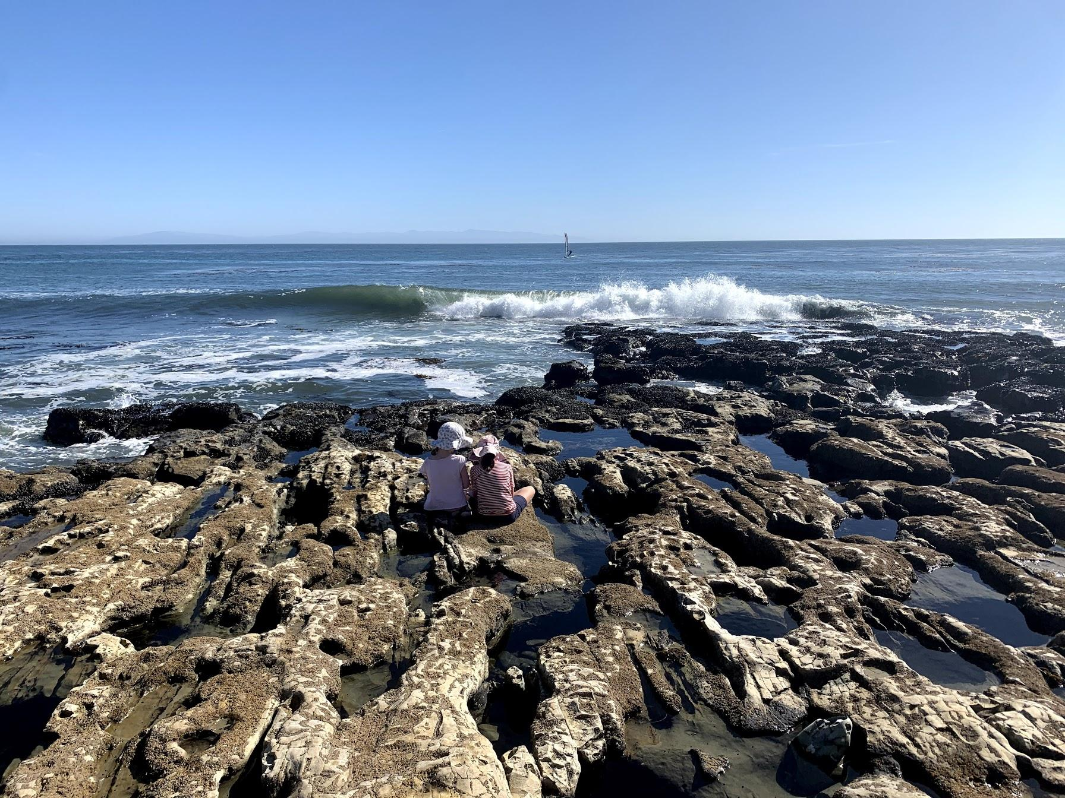
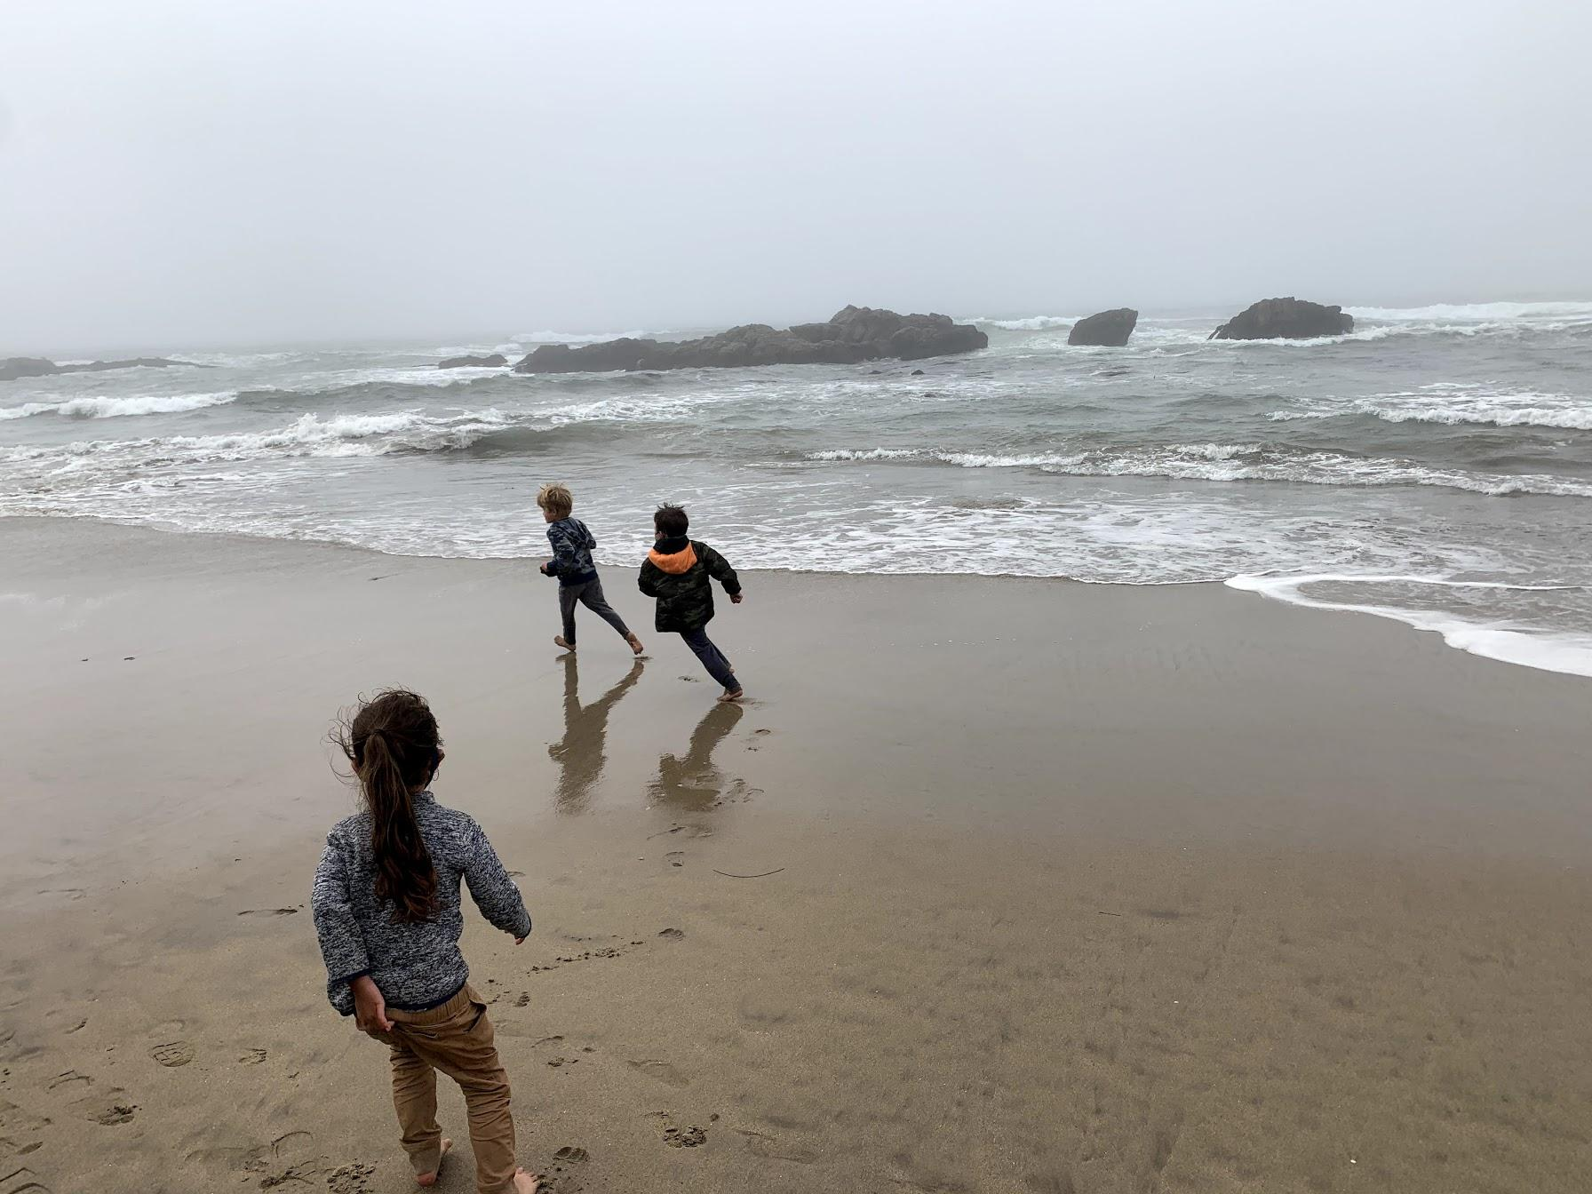
Week-Long overnight field trip
Hands-on nature exploration
Team building activities
Citizenship and stewardship
Notes:
In case you are not familiar with Outdoor School, we are a residential field trip program. We take a whole child approach through hand-on nature exploration and social emotional growth. We focus on ecology, environmental stewardship, and conservation, health and the arts.

Slide 3
NGSS at Exploring New Horizons
What we do…
Disciplinary Ideas
Science & Engineering
Practices
Crosscutting Concepts
Notes:
Exploring New Horizons Outdoor Schools align with state Next Generation Science Standards. These standards are all about connecting large ideas together, giving students confidence in doing science, and helping them understand the processes of the earth.

Slide 4
Where are we going?
Redwood Glen, Scotts Valley ★
Notes:
Exploring New Horizons has 2 sites. Your child’s class will be visiting our Sempervirens site located just outside of Santa Cruz in Scotts Valley. About 25 miles south of San Jose.

Slide 5
The Outdoor School Journey
starts at school!
Send them off with a smile!
Notes:
You will get a packing list that will tell you how many shirts, pants, socks, underwear- how much and what exactly to bring, so don’t worry about it just yet.
Students depart with their teachers and cabin leaders from their school the morning program begins.

Slide 6
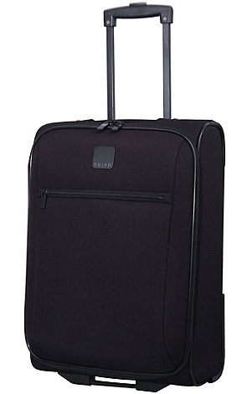
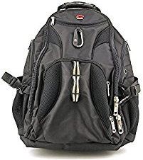
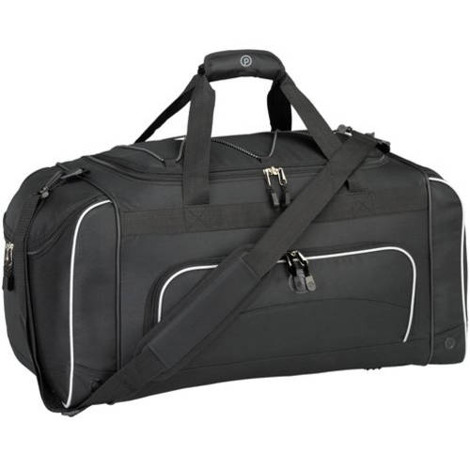
or
To pack your Sleeping Gear
To pack your Clothes
For taking on your
Day Hike
Notes:
But you need THREE BAGS-
a bag for your clothes (suitcase or duffel bag, whatever you have)
a bag for your sleeping gear- a pillow and sleeping bag or twin sheets and a blanket. We recommend bringing your sleeping things in a large bag that will keep your things dry in case it is a rainy first day. A garbage bag works great!
And a backpack for your hikes and for on the bus

Slide 7
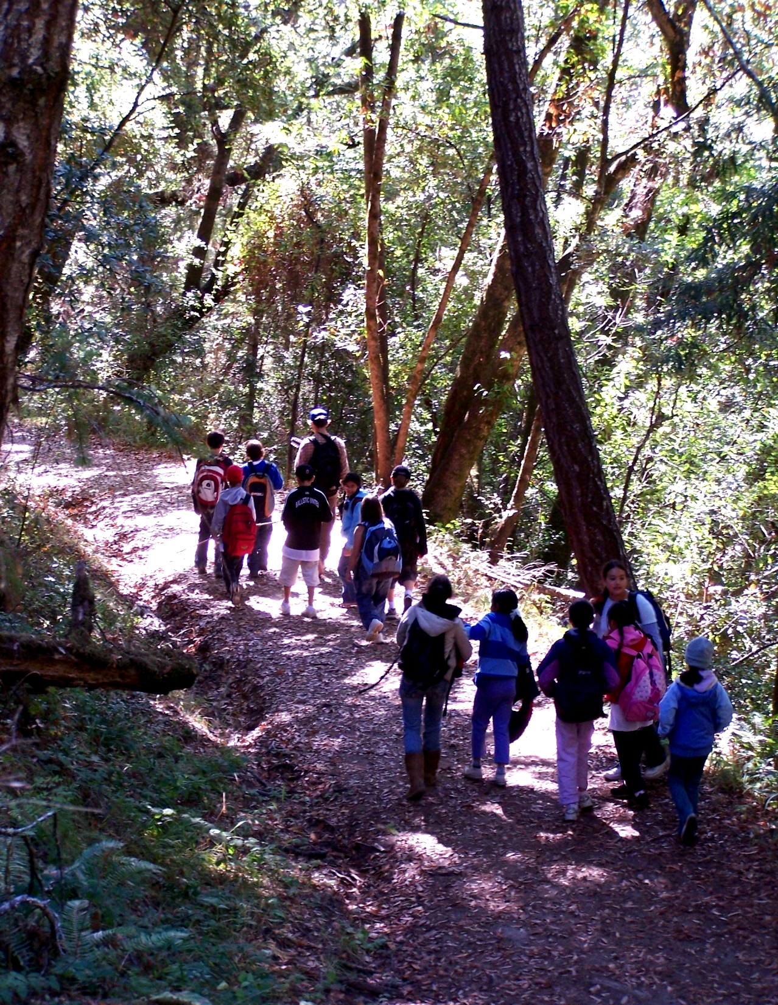
Be sure to pack:
Clothes you can get dirty
Comfortable shoes
Backpack
Layers
Water bottle
Notes:
The clothes you are packing should be clothes that you are ok with them getting dirty. It is OUTDOOR school- so we sit on the ground, rocks, sand, you will get a little dirty.
The shoes you will bring should be shoes you are comfortable walking around in most of the day, and shoes that you are comfortable with potentially getting dirty. The tennis shoes they wear at school are probably just fine. Remember to bring TWO pairs of comfortable shoes because one pair could get wet.
You need a backpack for every day- it will have your warm layers in it because it gets cool in the redwood forest and at night, and you need a water bottle. It can be a reusable water bottle or any sort of large water bottle, like a Gatorade container that you refill with water. Any sort of water bottle that will seal shut and not leak. You need to drink plenty of water at outdoor school since you will be hiking and active.

Slide 8
3 Approved Electronics
Camera (disposable recommended)
Flashlight (extra batteries)
Watch
Notes:
Last thing about packing- there are only three approved electronics for outdoor school.
A camera, your parents can send you with a digital camera if they want, but we have seen many of them break at Outdoor school, so we recommend a disposable camera.
You can bring a flashlight, or a headlamp
And a watch- just a normal watch without a fancy screen.
You might notice there is no cell phone or ipod or kindle on this list, that is for a few reasons.
We do not have cell phone service at Outdoor School. Our naturalists carry radios around on hikes so we can talk to the office if we need, and the office has a landline so we can call the school if we need.
We do not want you to lose it or break it
We believe that it is so important for everyone to have a screen free week. Less screen time more green time!

Slide 9
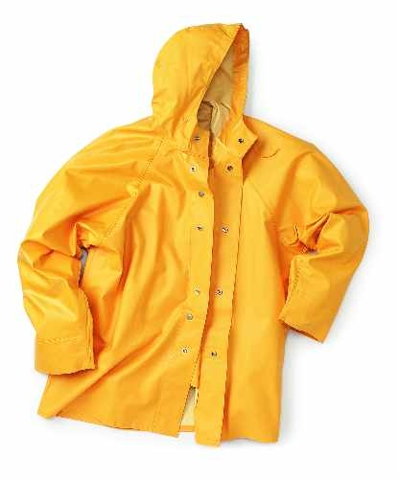
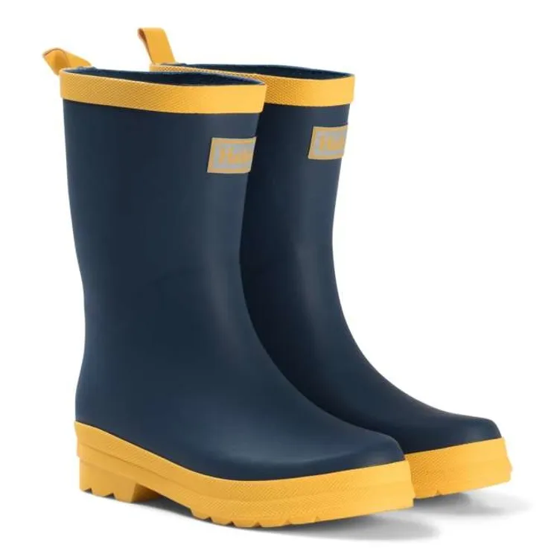
Don’t Forget Rain Gear!
Notes:
Also, please do not forget to bring rain gear. If it rains, we still go out and explore because that is when the forest really comes alive.
We recommend a poncho because they are small and light so you can carry it every day in your backpack just in case. Then if you need it, it is large enough to cover your backpack.
If it rains, you may get to see more newts, salamanders, and….

Slide 10
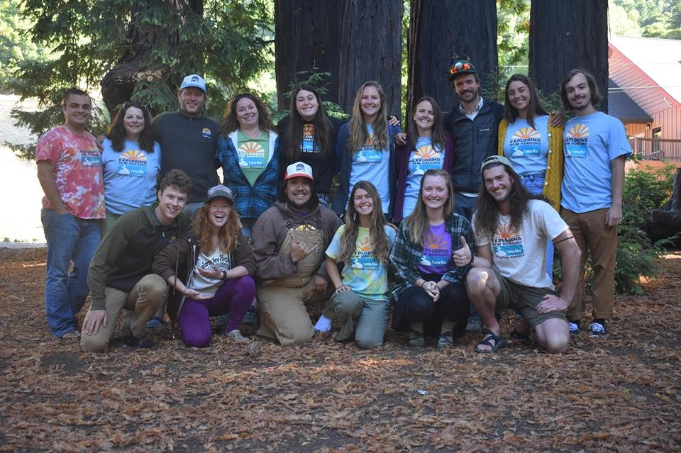
WELCOME!
Naturalists, Health Care Supervisor, Principal and Classroom Teachers!
We’re all here to help, just ask!
Notes:
When your child’s class first arrives, they will meet their Exploring New Horizons naturalists! Exploring New Horizons naturalists have many years of experience teaching and working with children. They are very talented, fun and caring people. They will be your child’s instructors for their visit, taking them hikes and leading all of the activities. They all have first aid and cpr training. Their classroom teacher and cabin leaders will be there for supervision and safety as well.

Slide 11
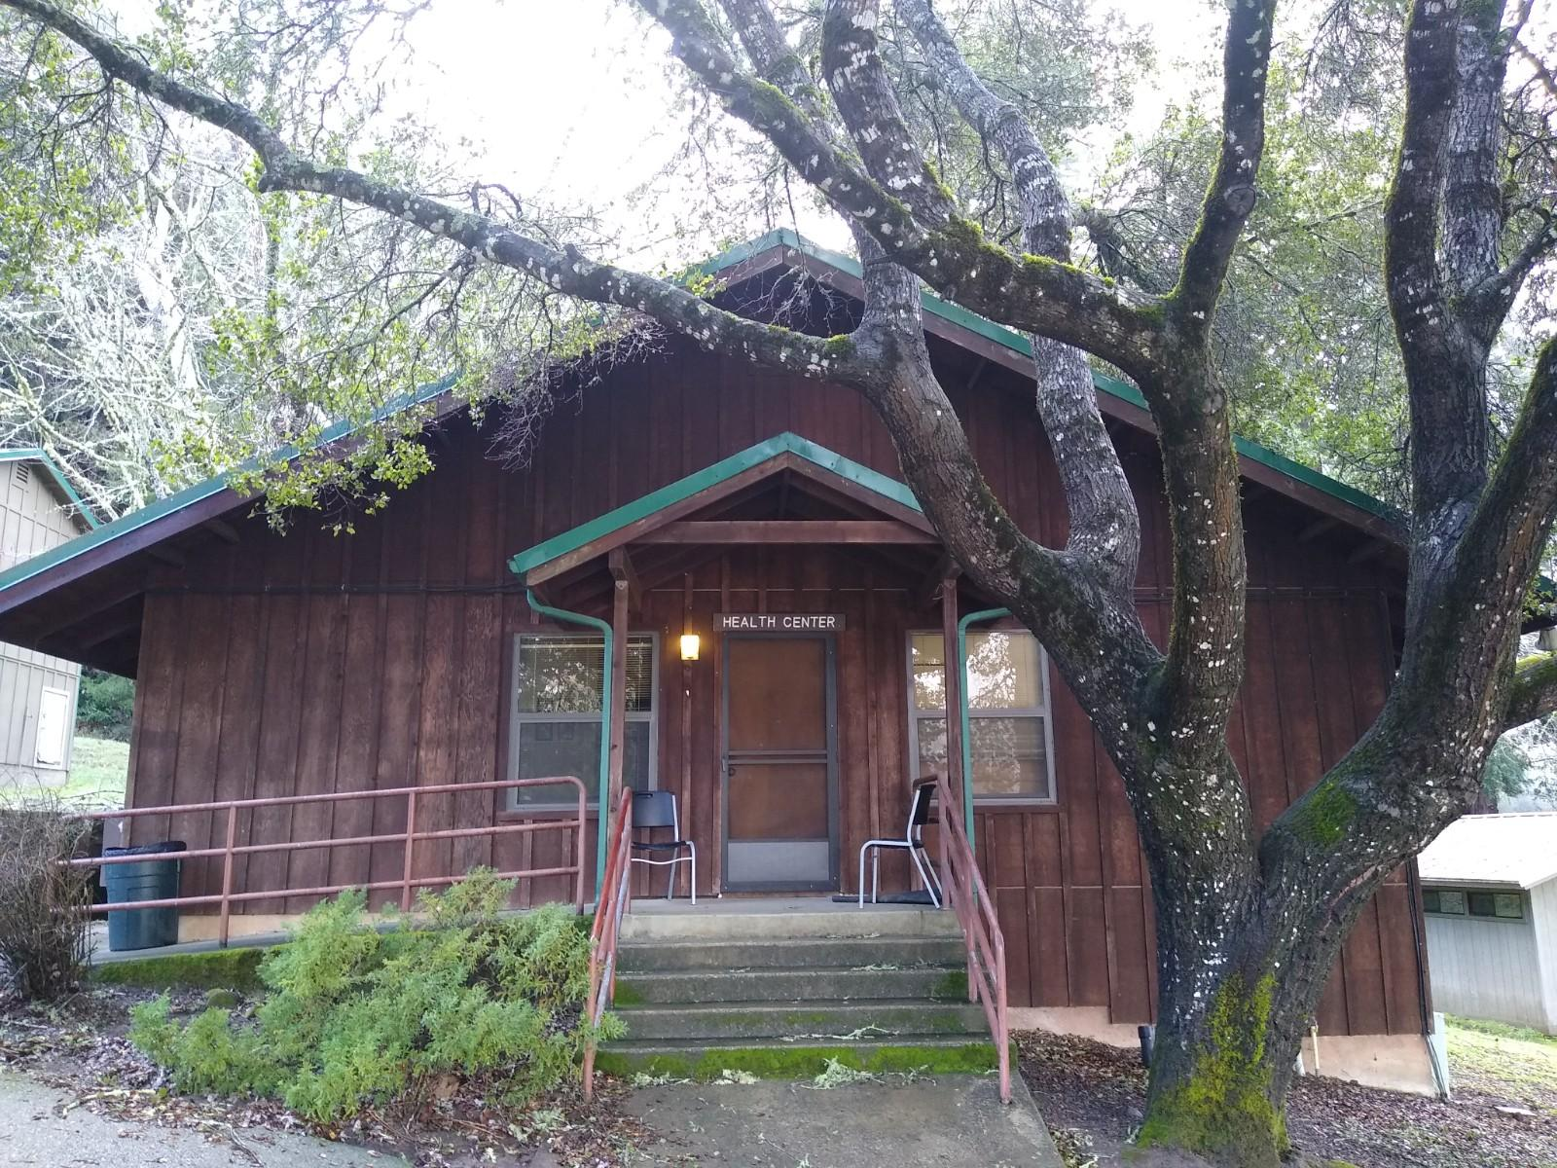
Health Care Supervisor & Health Habitat
All medications are kept in our health habitat
Keep your Inhaler & EpiPen with you AT ALL TIMES
No food or medicine in the cabins!
Notes:
Staff also have med kits and radios.
If you have medications: Make sure to write on the medical form, turn into our medic.

Slide 12
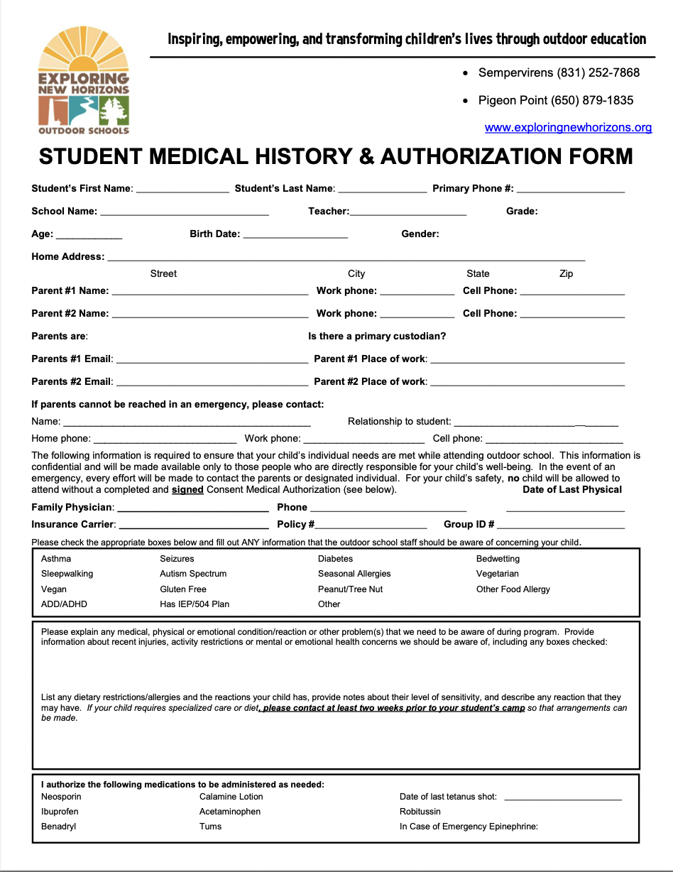
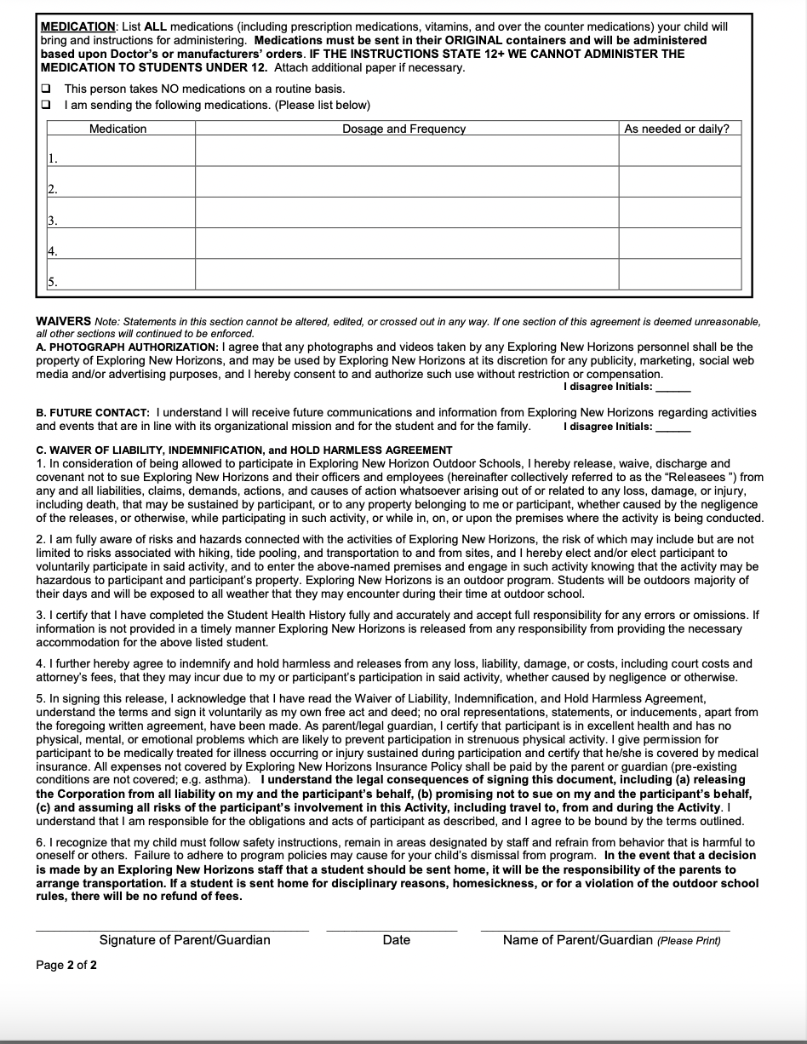
Student Medical History & Authorization Form
Notes:
This is an example of the medical form. Check off medical needs that apply and give us detailed information about your child’s medical and dietary needs. You can check Yes to give us permission to administer several medications that we have on-site. Any over the counter or prescription medications they take regularly need to be in a plastic bag, with their name, dosage, and time of day on it and documented on their medical form.
Teachers will share the link to a form that can be completed online by parents. Or a physical copy can be printed off our website.

Slide 13
Student Medical History & Authorization Form
FOR ALL MEDICATIONS: Name, dosage, and time given
HAS TO be sent in original bottle and in a plastic bag
Check boxes for our over the counter meds and First Aid
Car sickness, BW (bedwetting), SW (sleepwalker), and ST (sleeptalker)
Call or email our Director with questions or concerns @ daniel@exploringnewhorizons.org
Notes:
All medications being sent must include: name dosage and time given
-They need to be sent in their original bottle, and in a plastic bag
-Check boxes for our over the counter medications you want to authorize
-For question, you can call or email or program director or health supervisor

Slide 14
Tips for a Healthy Trip!
Keep sick kids at home
Wash hands
Sneeze into elbow
Pack a water bottle and plenty of sunscreen
Encourage your student to ask for help from our naturalists, teachers, and cabin counselors!
Notes:
Staying Healthy at Camp

Slide 15
Covid-19 Policy
Pre-Program
All ENH staff is vaccinated
Attending Teachers and Cabin Leaders must be vaccinated to attend
Students, Teachers, and Cabin Leaders with symptoms of COVID-19 will not be allowed on the bus
Testing prior is encouraged but not required
Updated Ventilation system
During Program
ENH staff and cabin leaders will conduct daily symptom checks
Nearly all activities and learning take place outside
Before arrival at the outdoor school, students will be assigned to cohorts (cabin groups of 8-12 students and a cabin leader) that will remain together for the entire week of outdoor school without mixing inside their cabins or bathrooms.
Students will wear masks indoors (exception: dining hall and cabins) and be grouped with their cabin cohort
Notes:
COVID-19 Policy

Slide 16
Covid-19 Policy
Symptom Response
Anyone showing symptoms of COVID-19 must be immediately removed from the program and isolated. An isolation room will be provided in the infirmary to separate anyone with COVID-19 symptoms from others needing care. ENH will arrange safe transportation home or to a healthcare facility (if severe symptoms) for the student or cabin leader with the participants’ parent or guardian. ENH will close off areas used by a person showing symptoms and will not use these areas until after cleaning and disinfecting them. All isolated students or cabin leaders will still be under adult supervision and will receive ample reading and drawing materials and attention from the Health Care Supervisor or another staff member while waiting for their parent or guardian to pick them up.
For more information see our full COVID-19 Health & Safety Plan
Notes:
COVID-19 Policy

Slide 17
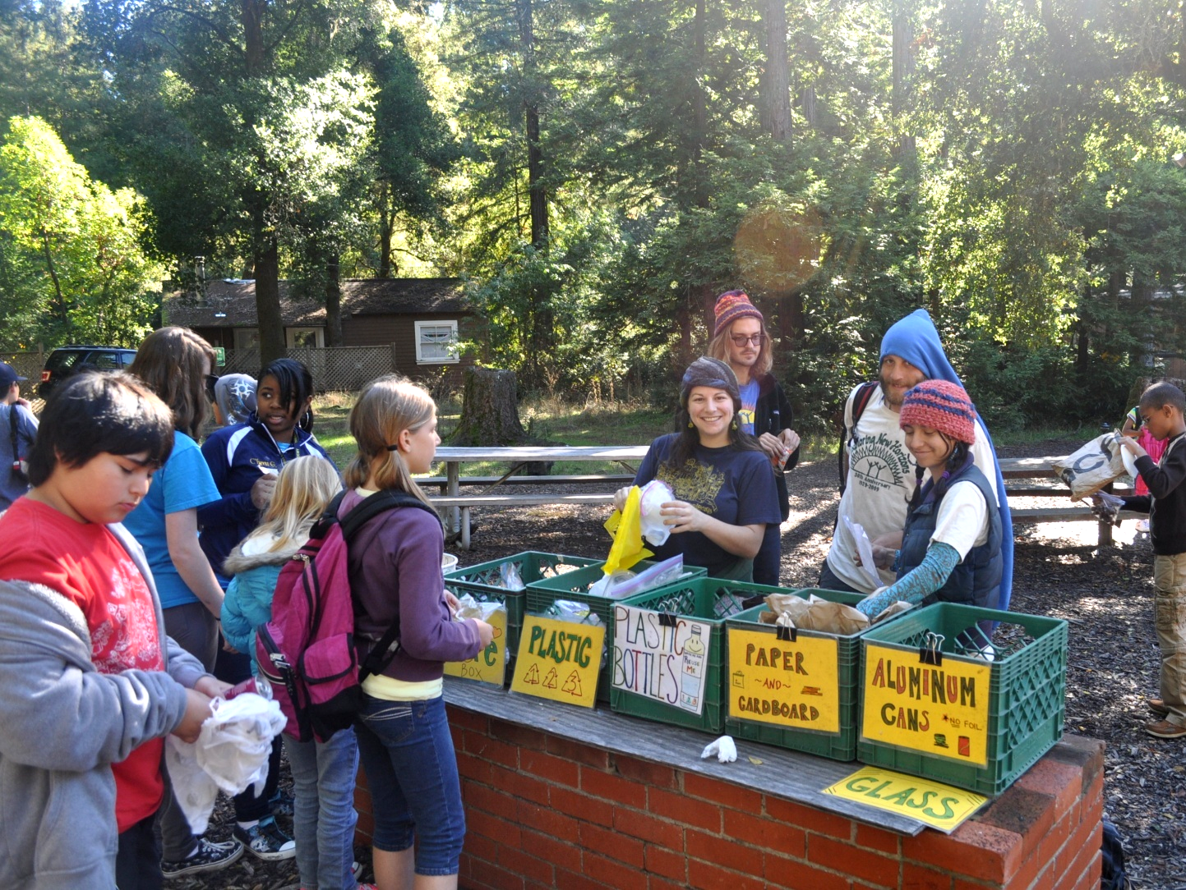
Bring a LUNCH for the first day…
Remember to pack a water bottle!
Notes:
Please send a lunch for the first day. This is the only time that students will be allowed to have food on them, we do not allow food or snacks of any kind in the cabins or in their suitcases.

Slide 18
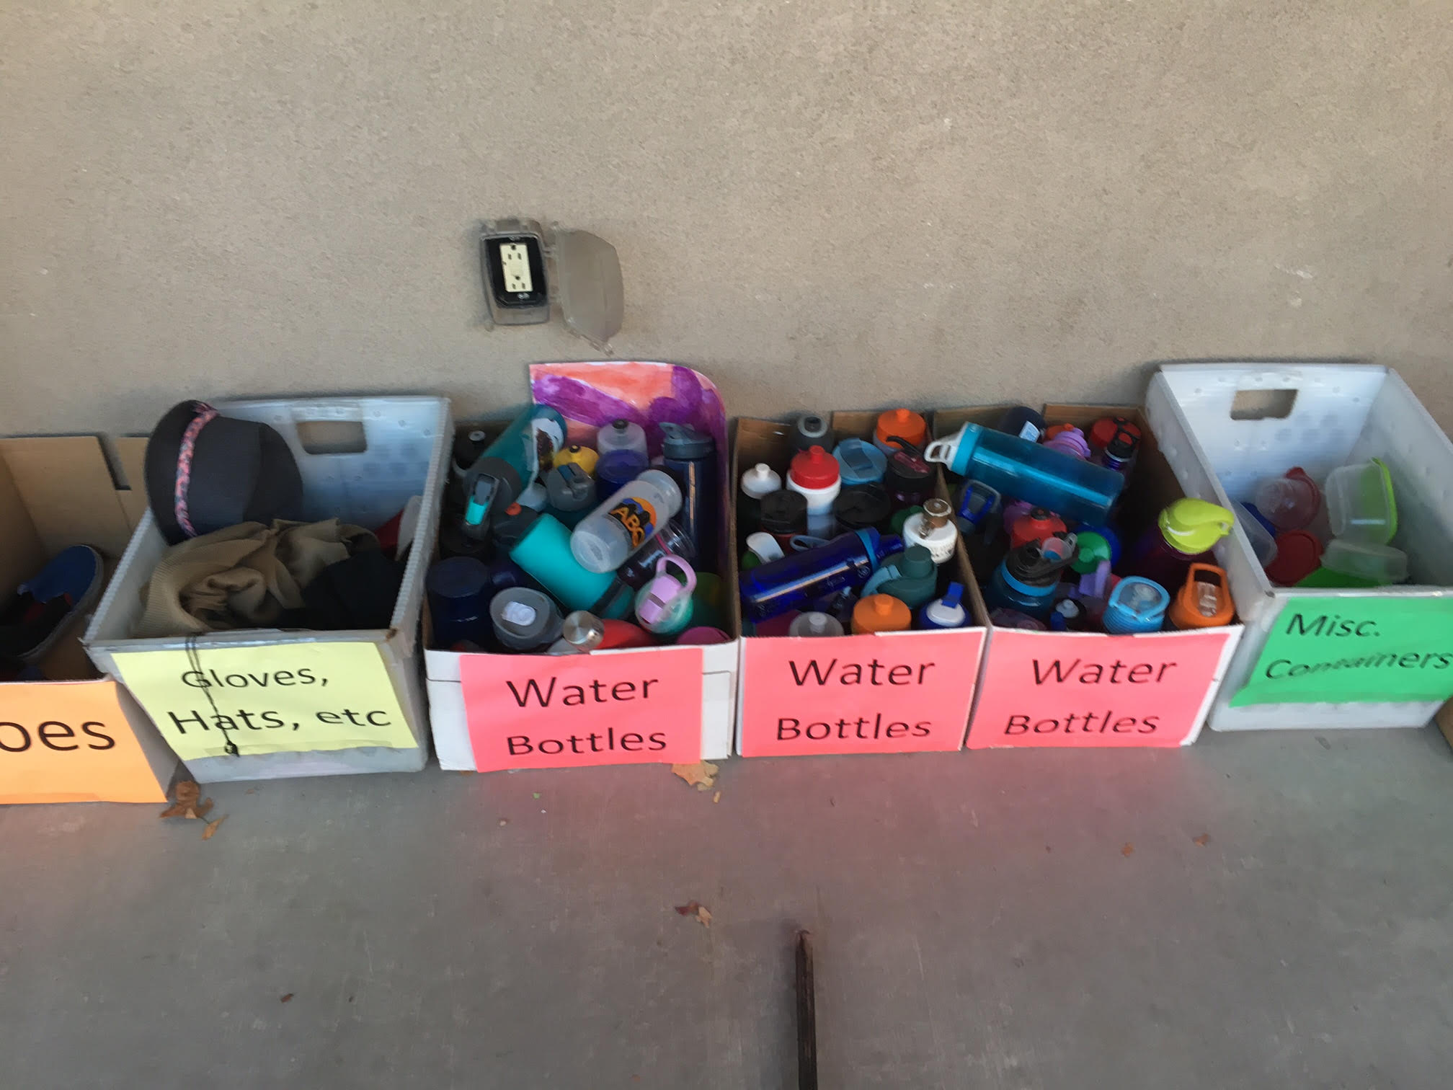
Label Everything
Notes:
Sweatshirts, jackets, clothing, water bottles, backpacks. This is the first time many kids are away from home and a responsible for all of their personal belongings. Things get left behind and it makes it much easier to return them to their owner if they are labeled.

Slide 19
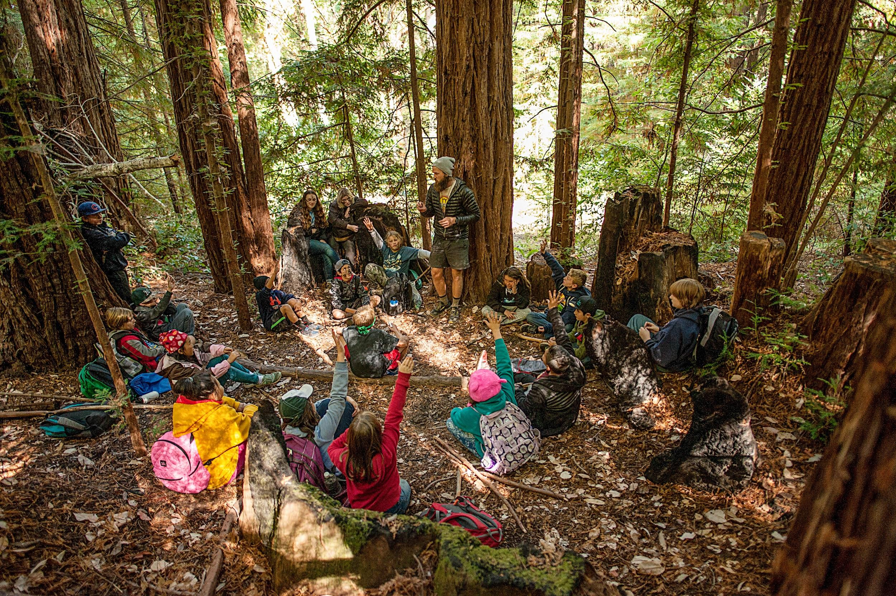
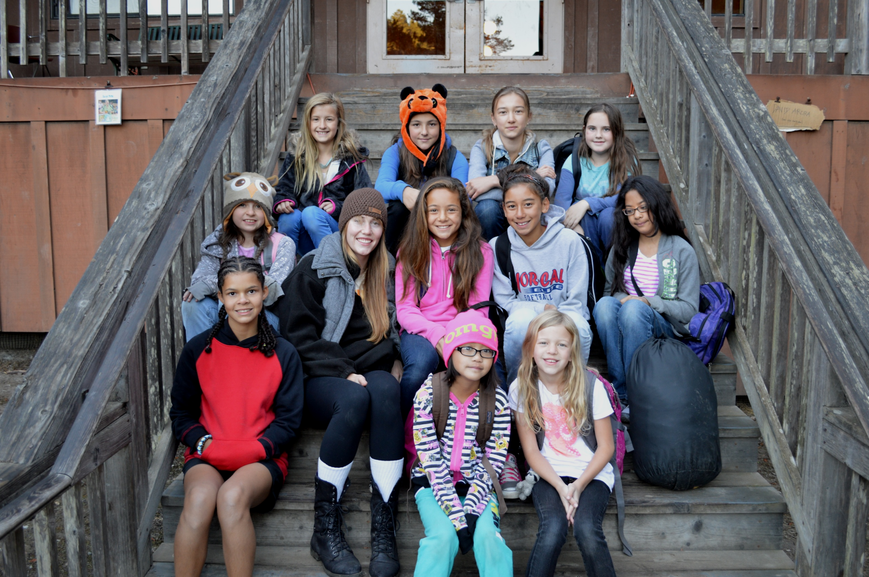
Cabin Groups!
7-11 students & Cabin leader or parent!
Notes:
When it is time for move in, we will give the class time to take a tour of the their cabins and then we will have a move-in meeting. During the move in meeting, we will talk about rules in the cabins and at Outdoor School, and how they can successfully share the dorms with with their classmates and cabin leaders. We will also talk about what to do in the case of an emergency, the daily schedule and all of the important stuff that they need to know to stay safe and have a great time at Outdoor School.

Slide 20
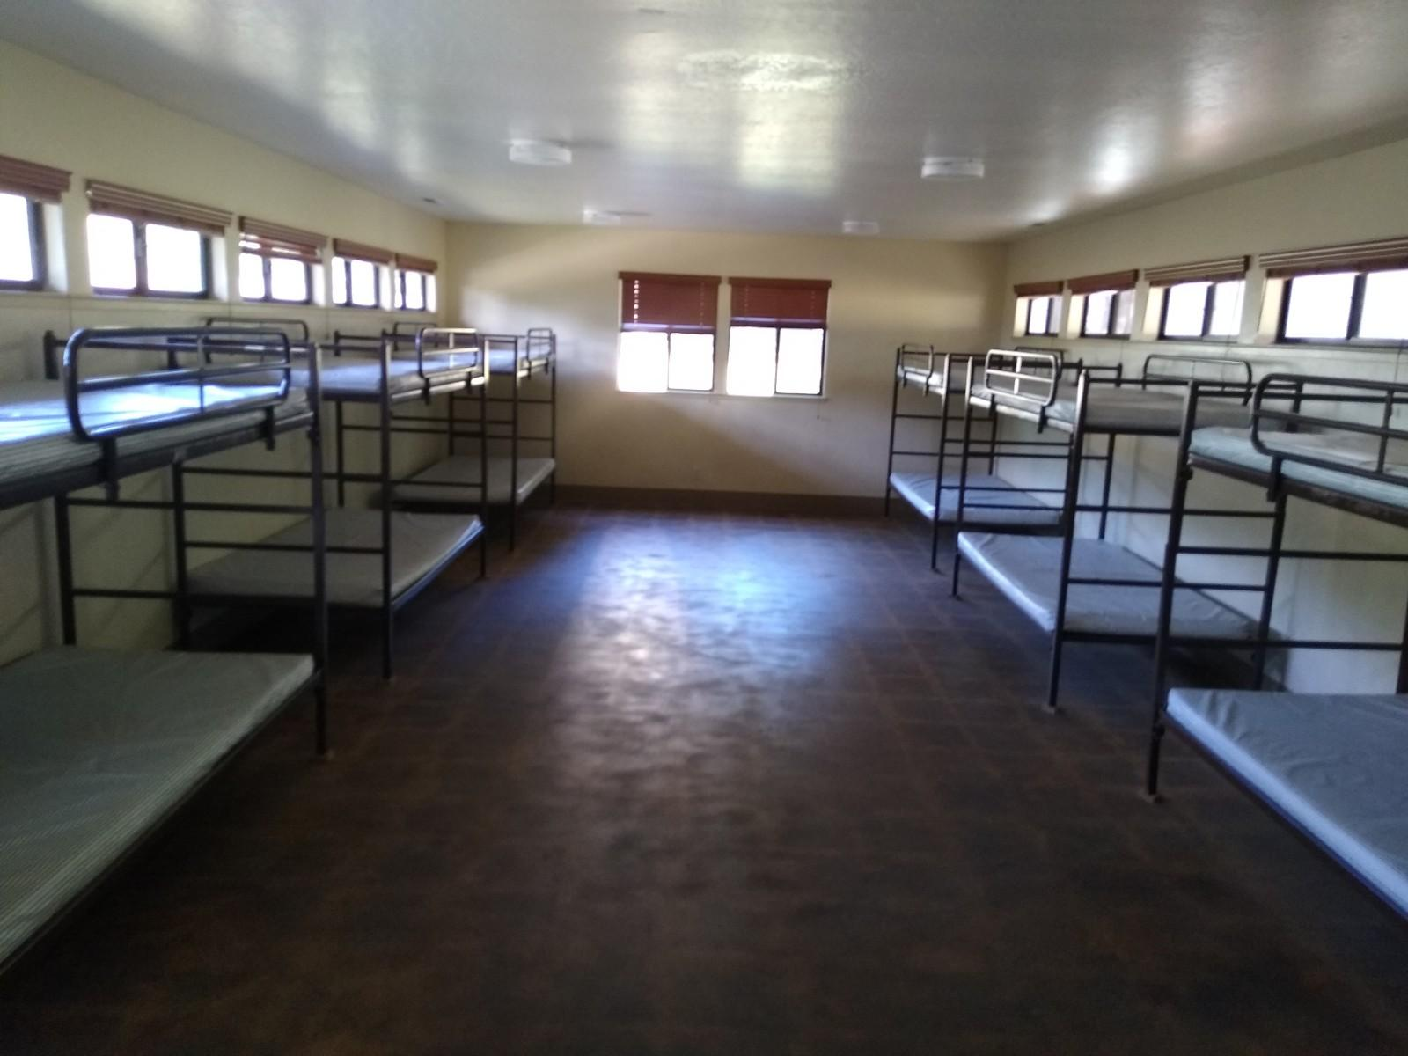
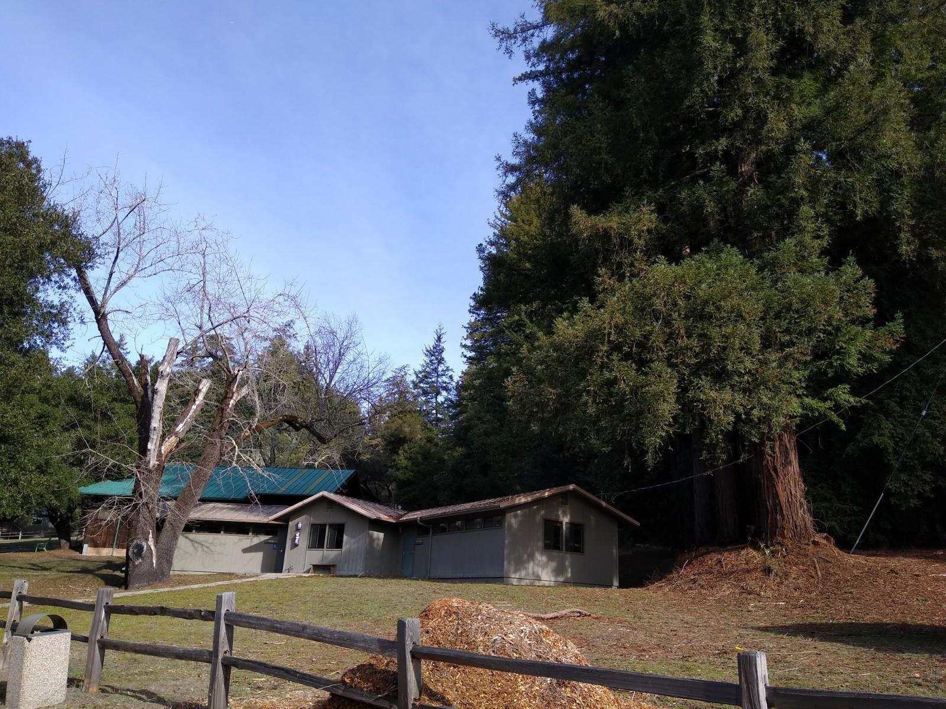
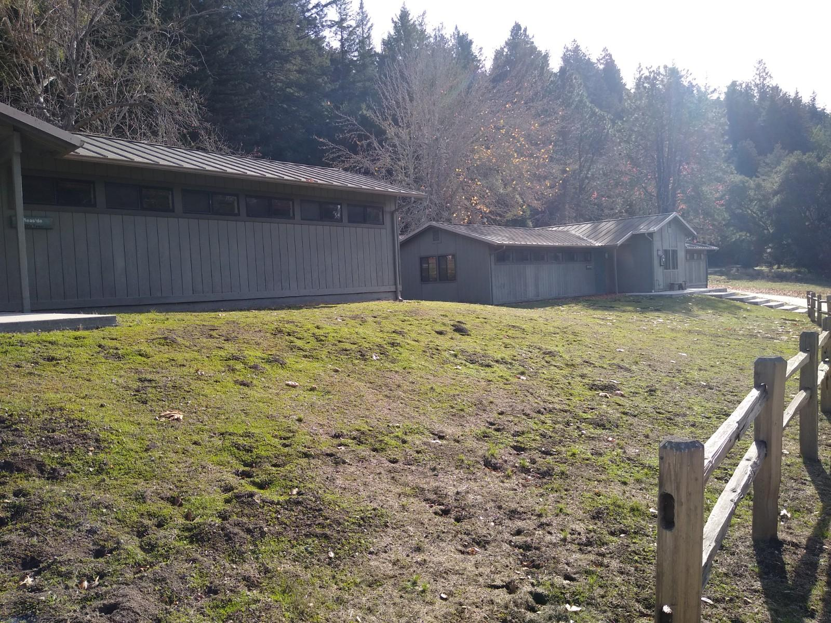
Dorms!
Personal space
Bunks with Mattresses
12 bunks per room
2 showers and 2 toilets
Notes:
After the move in meeting they will get to move into their dorm room an assigned their trail group! There are 12 beds, a 2 bathroom stalls, 2 showers (with locking doors for privacy), hot and cold water, and plenty of space!

Slide 21
BATHROOMS
Hot water
2 showers
2 toilets per dorm
Individual showers
Bathing Suits?!
= SUPER FAST SHOWERS
Notes:
The bathrooms have doors and locks for privacy, 2 toilets, and 2 showers. The bathing suits you will see on the packing list is for the students to shower in and then move out of the shower to change. This helps with efficiency of our 2 minute shower system as well as crowding in the bathroom!
If they ask- we recommend they shower at least twice for a five day program, and at least once for a 4 day. They cannot shower on Monday or Friday.

Slide 22
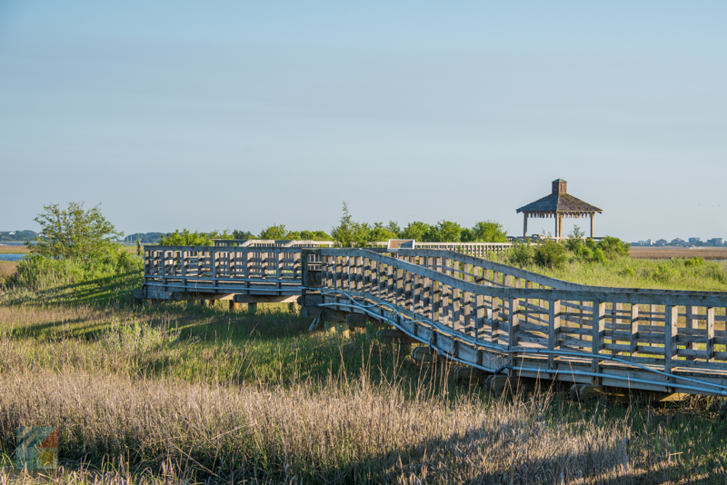
Expectations
BE RESPECTFUL:
Respect ALL living things
(plants, animals, and people!)
No put-downs or roughhousing
Other cabins are OFF LIMITS
BE SAFE:
Stay within boundaries
Please Walk!
Buddy system!!
BE KIND:
Include everyone
Have fun
Notes:
The Program Director is going to review the rules with you on the first day.
Respect all living things, so we do not pick green plants out of the ground. If we see an animal, we are going to give it distance and watch it quietly, or if it is small enough to pick up, we will ask a naturalist first. We respect people, that is a huge part of outdoor school!
That means no put-downs or roughhousing- no real or fake fighting
Other cabins and villages are off limits. So if you have a friend in another cabin or village and you want to hang out with them during free time, you can hang out at one of the designated places that we will talk about soon with Recreation time
There are many hills, sticks, and rocks around, so we ask that you please walk around our camp. You will have plenty of opportunities to play games and run around during appropriate times
Your naturalist will be marking your boundaries everywhere that you go, so please follow those directions to keep you safe
Wherever you go, you should never be alone. You are expected to take a buddy to the bathroom, to see the medic, anywhere you go. We do not want you to get lost.
These rules are here so you can have fun!

Slide 23
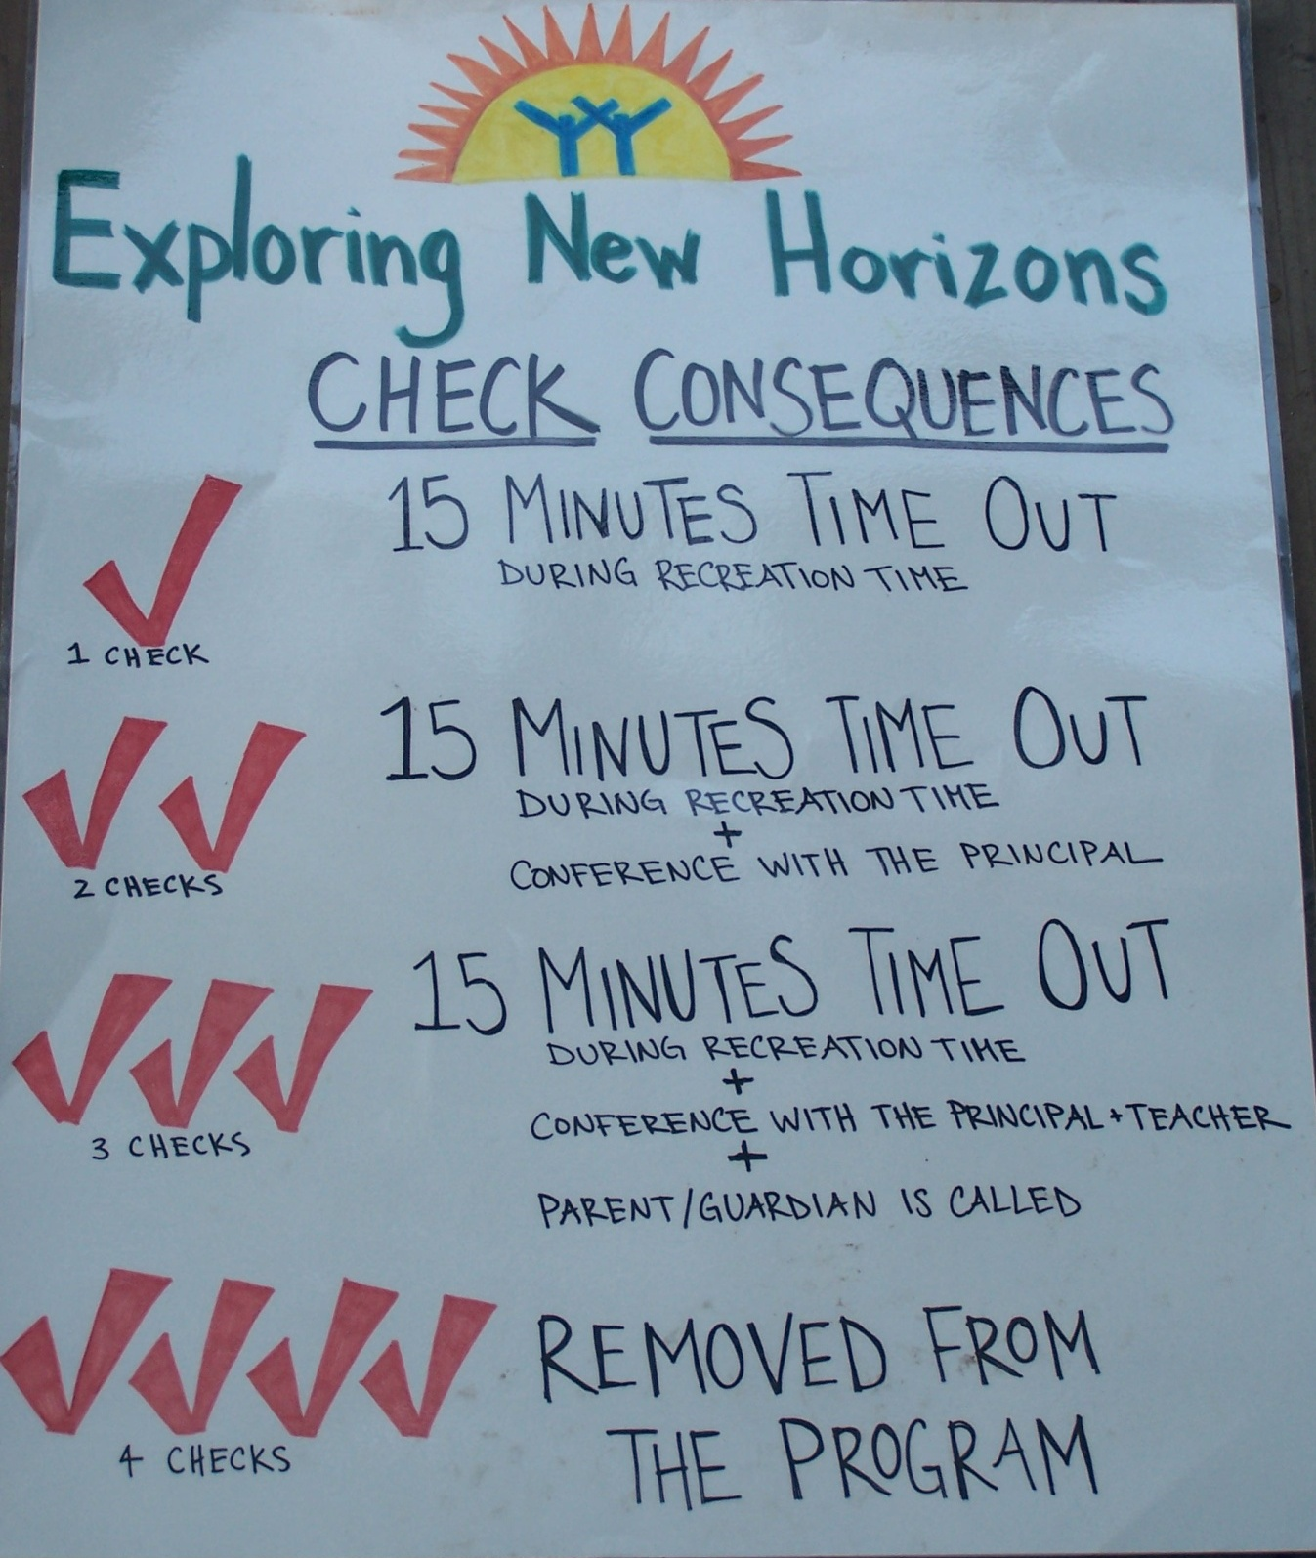
Our Consequence System
Notes:
After a tour of the facilities, your students will join all together once again for our opening ceremony. Here the staff will go over our expectations for the week, this includes our 3 respects! Ways we can respect ourselves, respect others and respect the environment during our week at outdoor school!

Slide 24
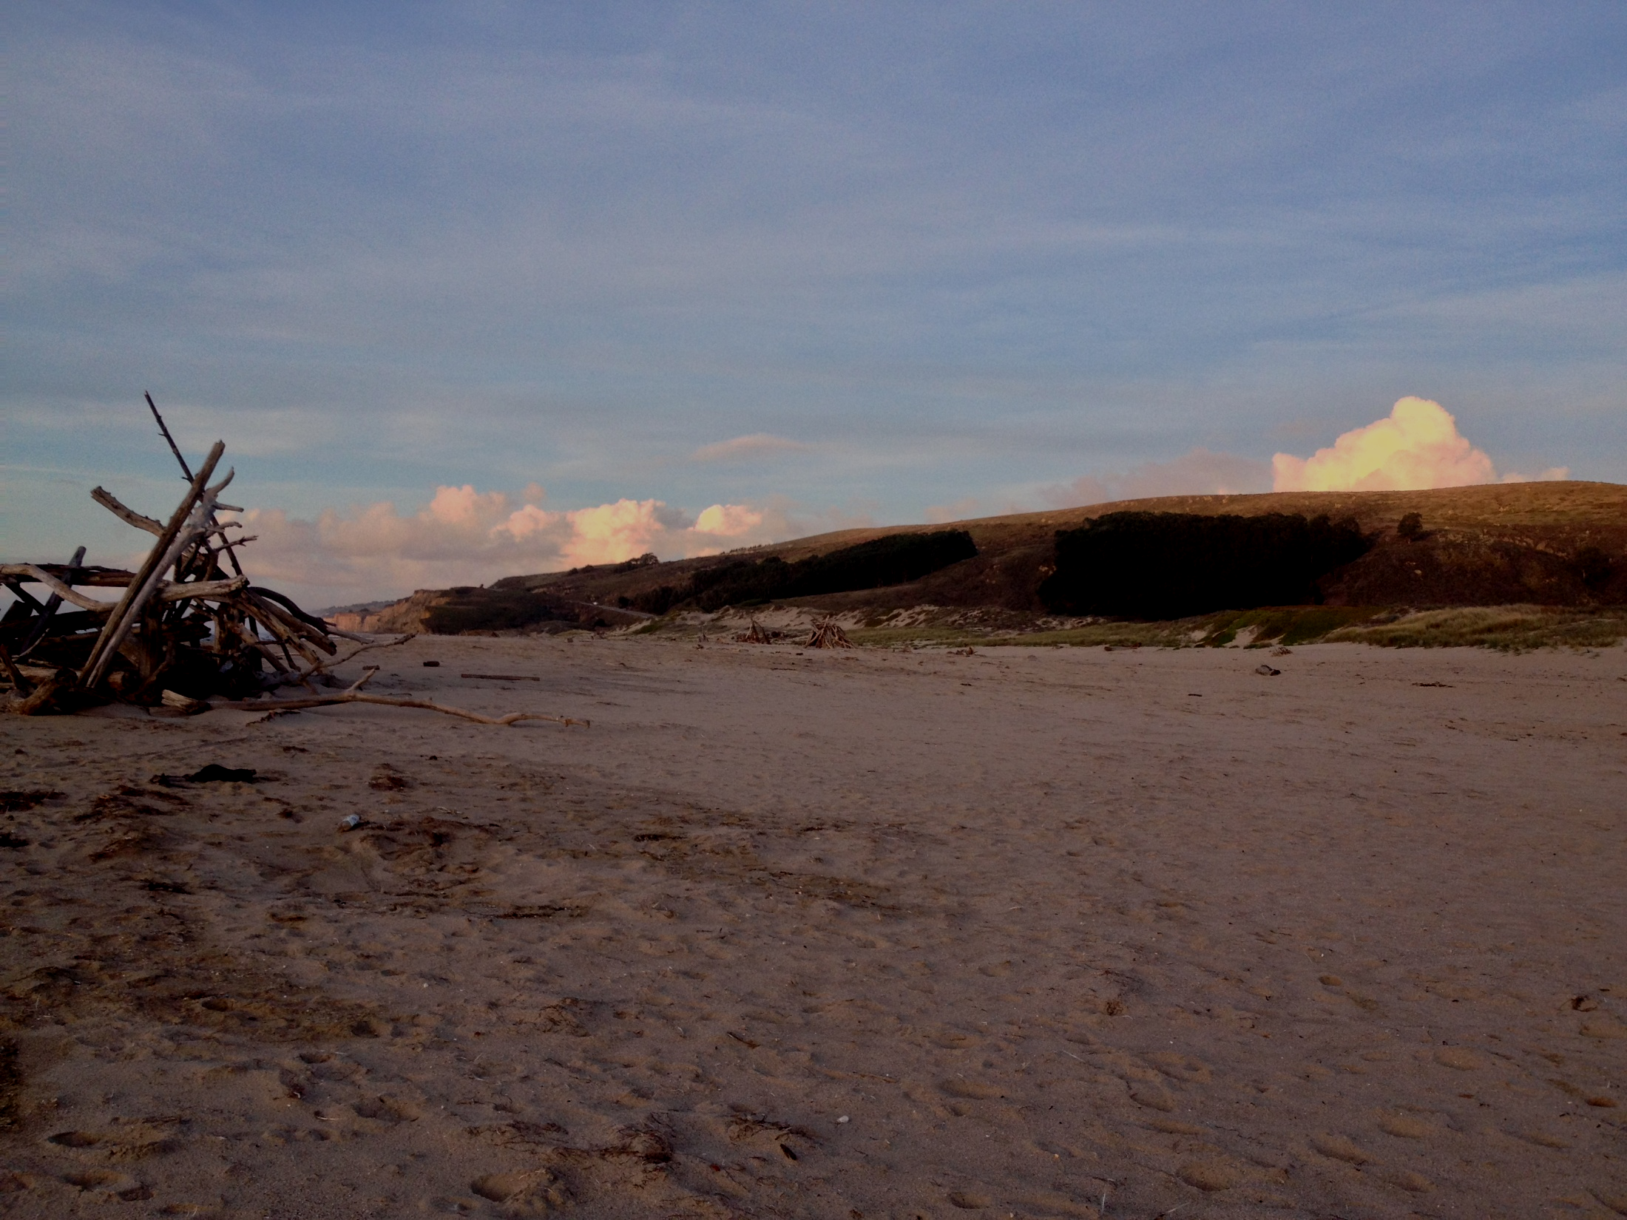
7:00 Wake Up!
7:45 Breakfast
9:15 Music Set
10:00 Day Hike
(with Picnic Lunch!)
3:00 Recreation Time
3:45 Teacher Time
4:45 Cabin Time
5:45 Dinner
7:15 Evening Activity
8:30 Campfire
9:30 Lights Out!
Notes:
This is a general schedule for each day. 7am your student wakes up to get ready for breakfast in the dining hall at 7:45. After breakfast is a time to sing songs and get warmed up for the day. From 10 to 3 is your student is spending time out in the forest or at the beach. It's a time for hiking, exploring, doing experiments and activities! After that is recreation time, then time with your classroom and teacher, then you have some time to relax before dinner. After dinner is an evening activity, a campfire, then lights out is at 9:30.

Slide 25
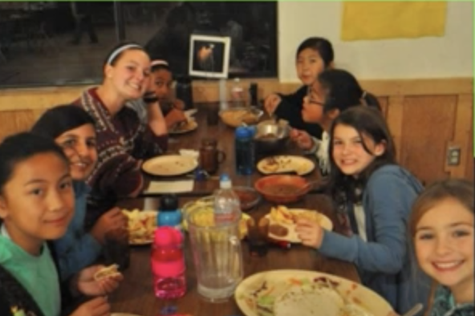
Breakfast and Dinner
Group style dining
Track food waste
Learn about compost
Food for EVERYONE
Notes:
When the meals are ready we all sit together in our common dining hall. They'll sit with their cabin and their cabin leader. At the end of these meals we set goals for lowering our food waste and talk about our composting options for the week! Please note that we are peanut and tree nut free. If your child has any food allergies please give us details on their. We will be able to make accommodations, just let us know!

Slide 26
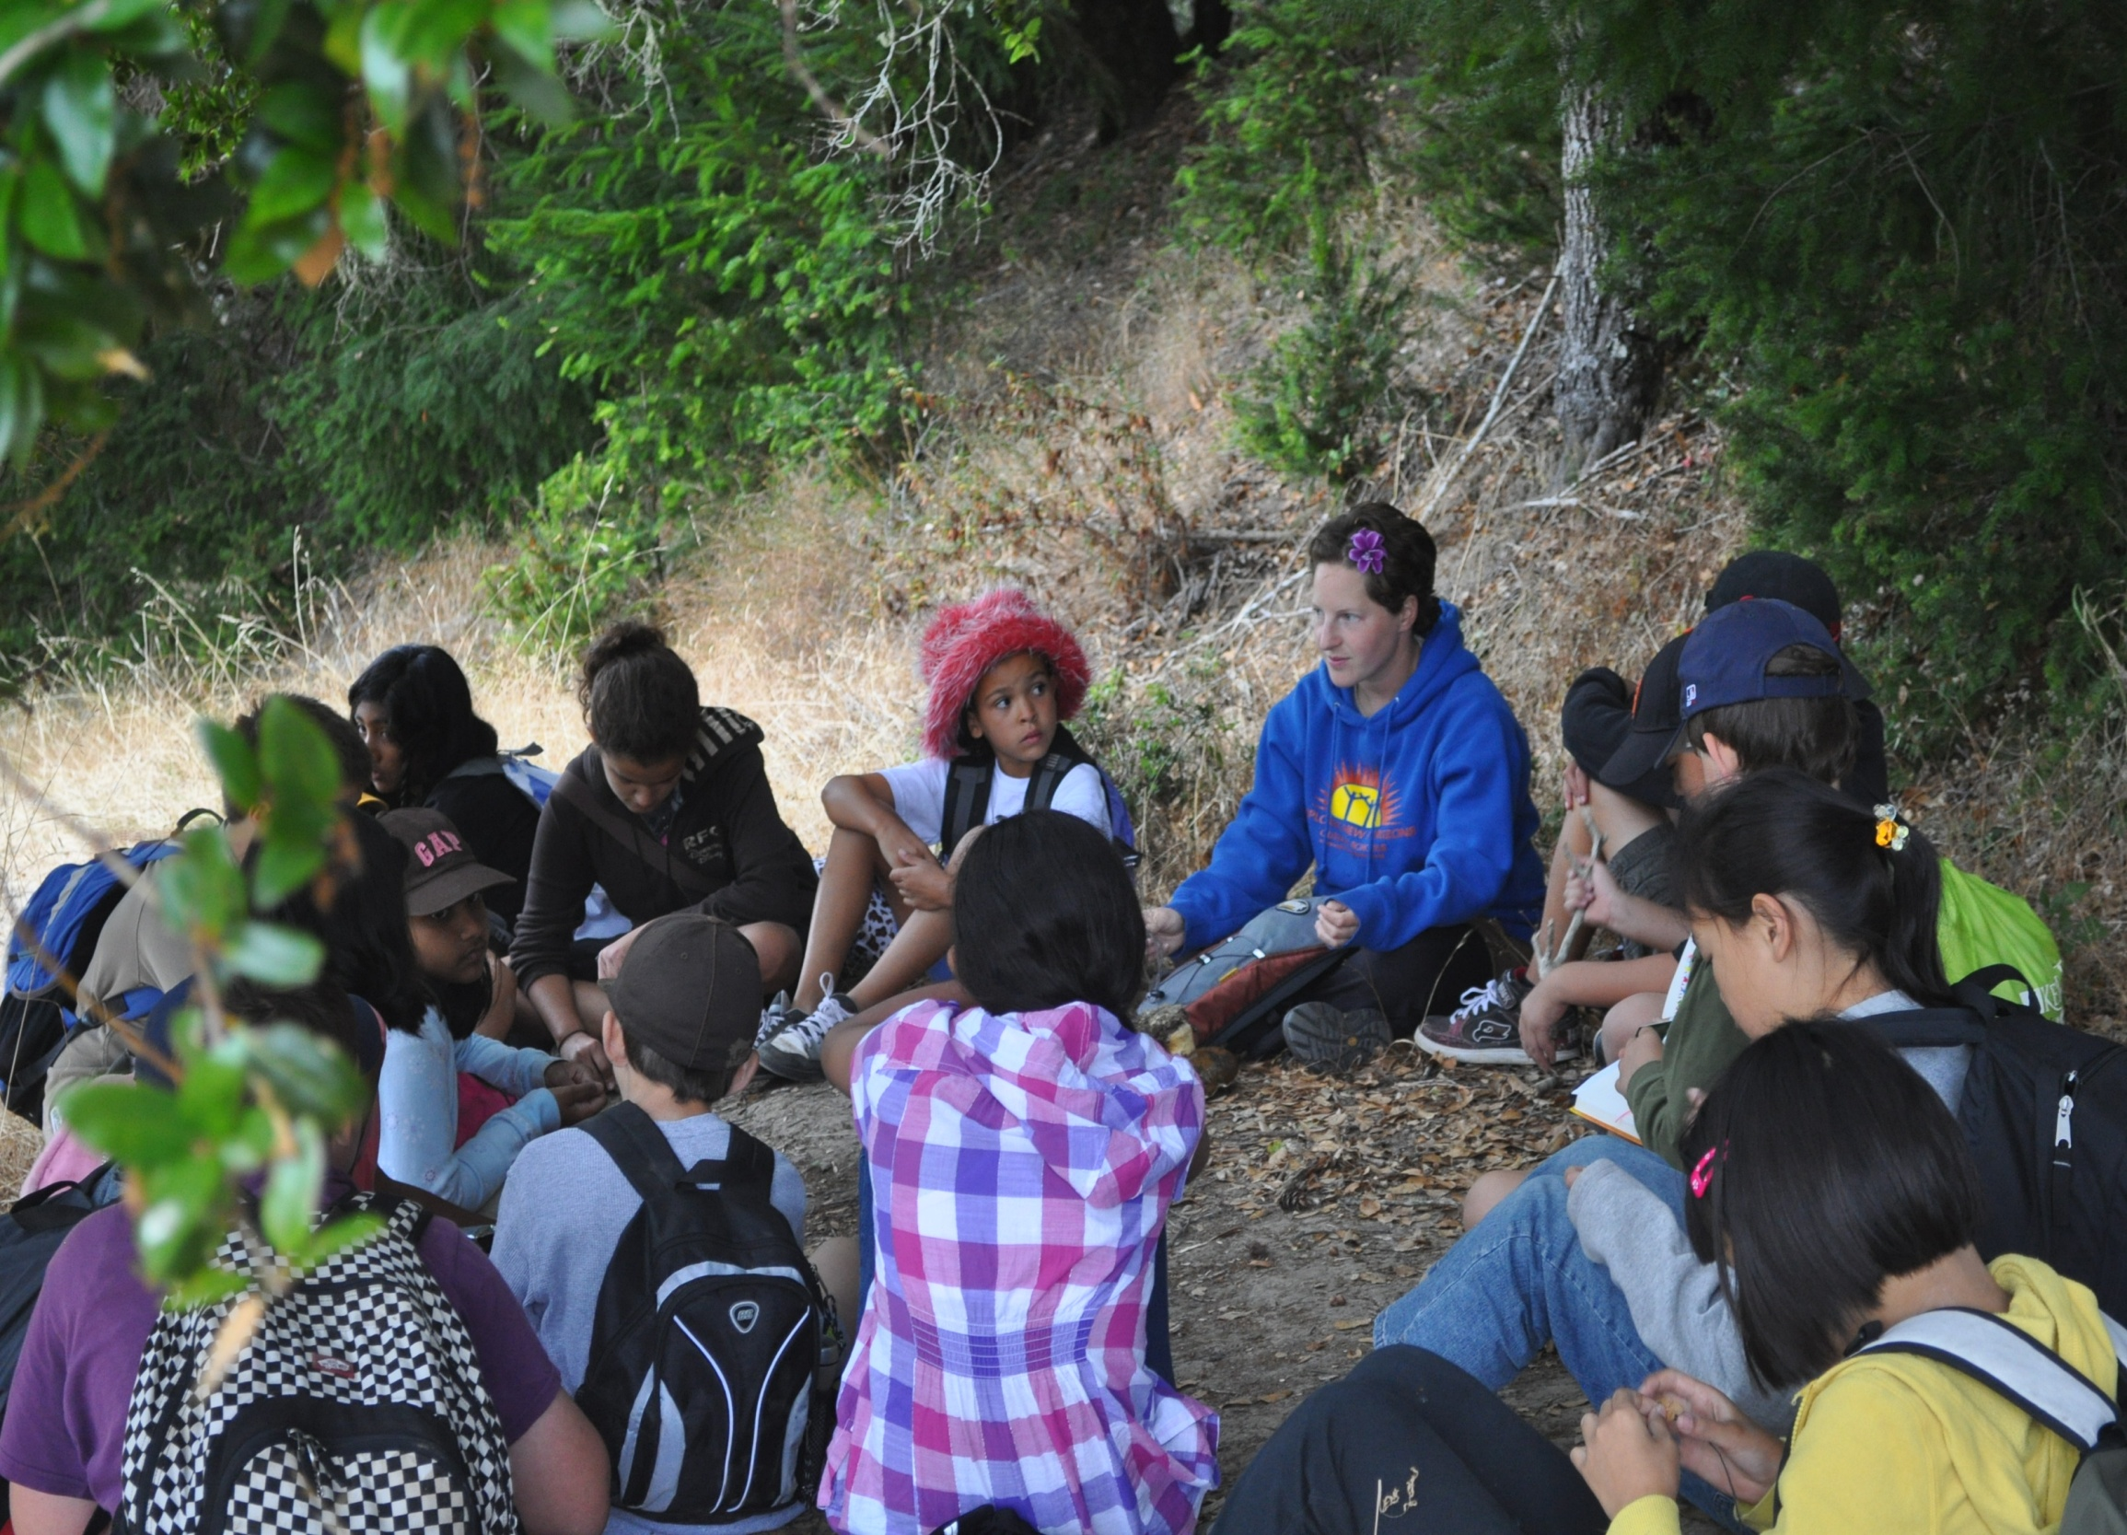
TRAIL GROUPS
1 Naturalist
+
2 Cabins with Parent/Cabin Leader
+
18-23 students
Notes:
After breakfast they will meet up with their trail group to spend the day with their trail groups! You will be spending that 10 to 3 time with a trail group. This is one cabin from one village, and another cabin from the other village. You will have both Cabin leaders/Parents and a naturalist, and this group stays the same for the week. The cabins are named after different plants, animals, or fungi, and the trail group is named after a famous naturalist who they will learn more about during the week!

Slide 27
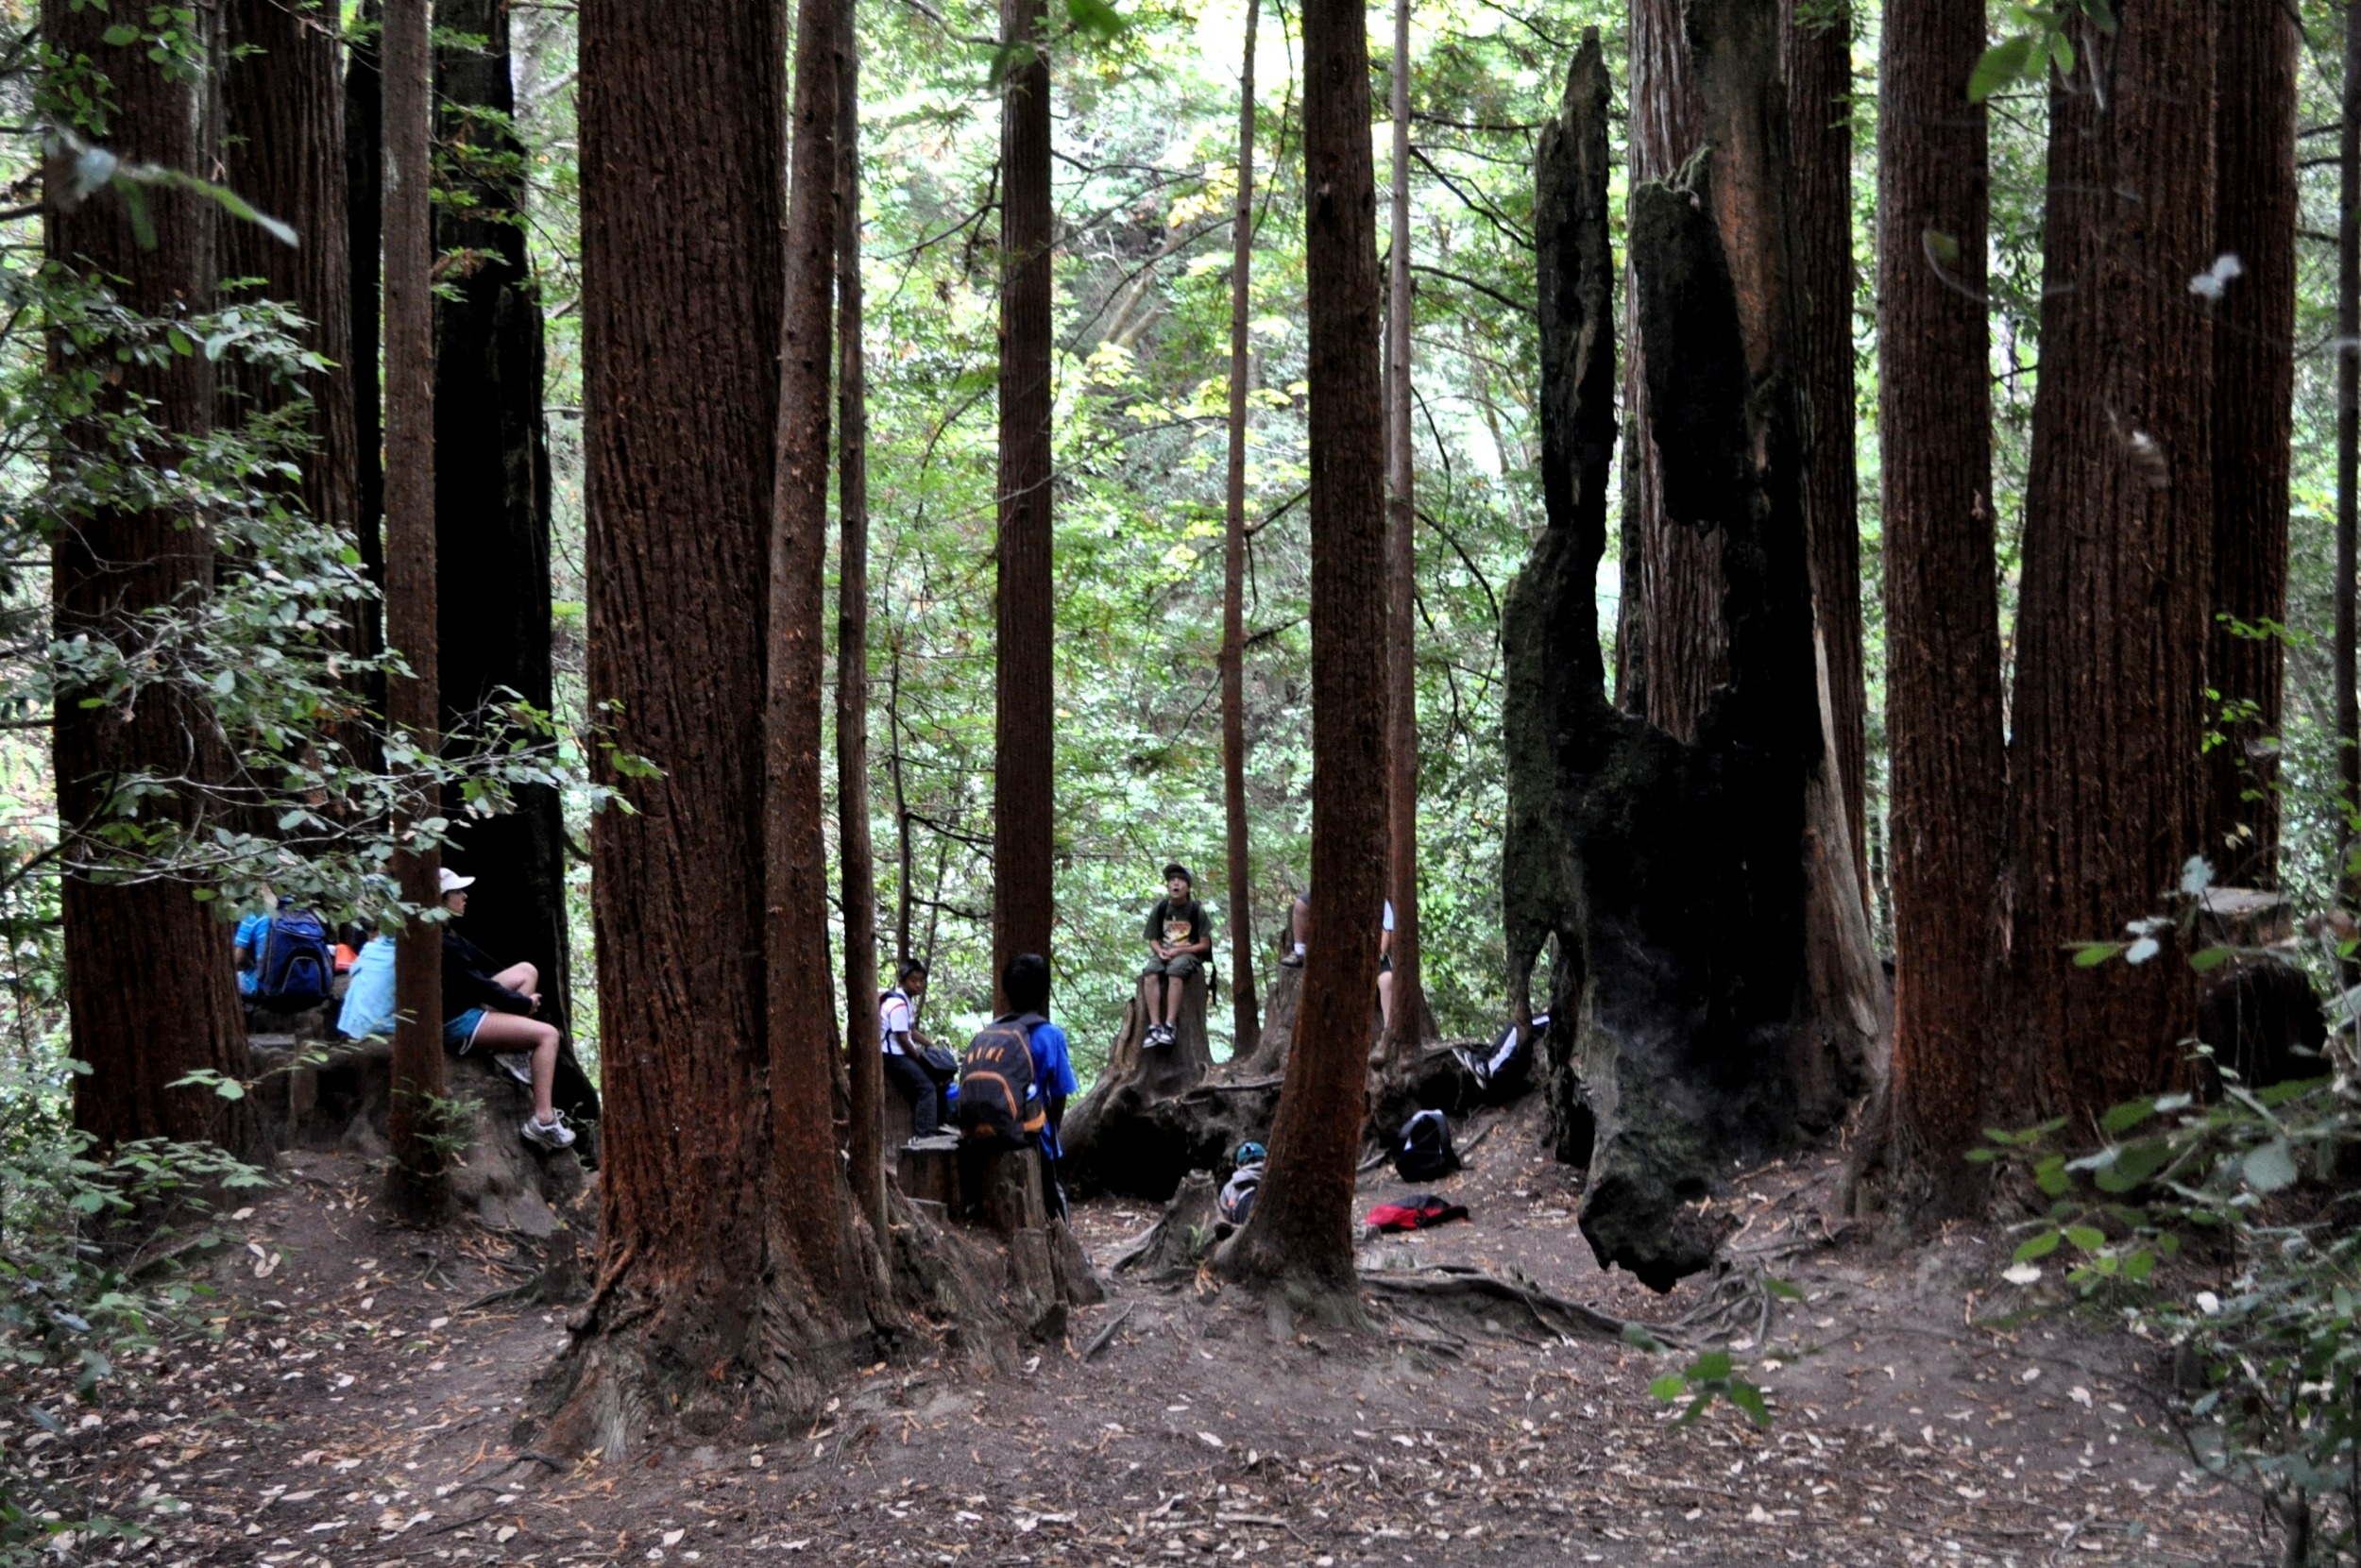
Our outdoor classrooms…
Notes:
Now let’s talk about some of our outdoor classrooms where we will be hiking, learning and exploring! Your child’s teacher will give you a detailed schedule of what days we will be doing each activity. Every program has a slightly different schedule as it is created especially for each class!
Students will be learning about the redwood forest and what makes redwood trees so special. As you may know, they are the tallest trees on the planet..

Slide 28
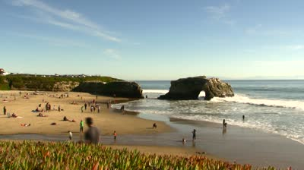
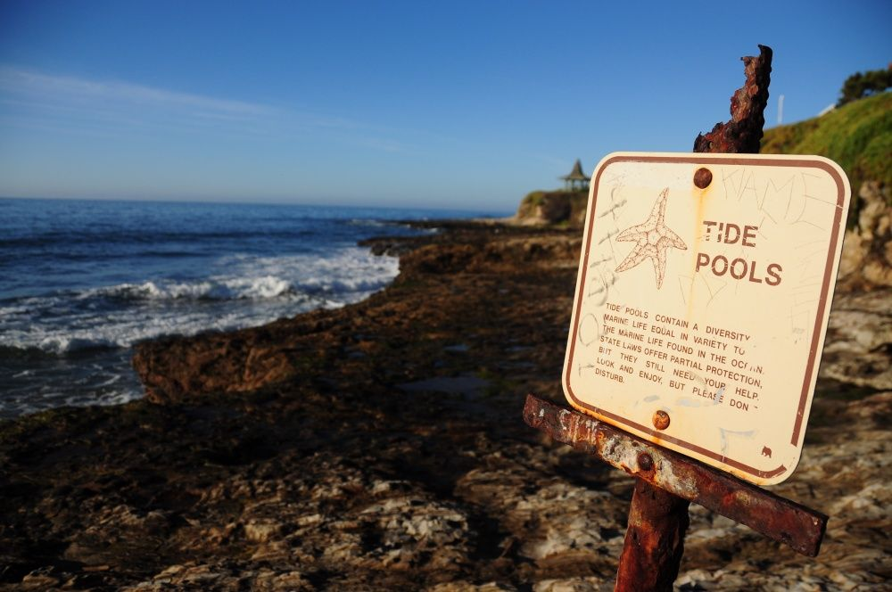
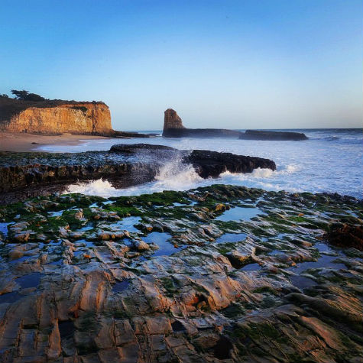
BEACH DAY!
At Natural bridges state beach
Notes:
Another fun outdoor classroom that we get to enjoy is the beach! We may play some games, find beach treasures, and have some free play time on one of the beaches located at Natural Bridges.

Slide 29
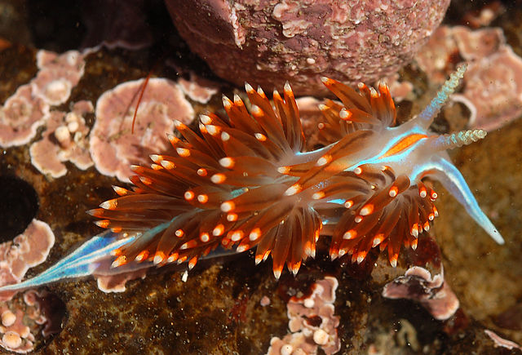
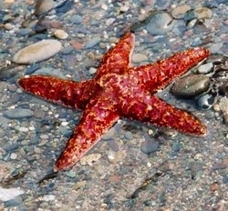
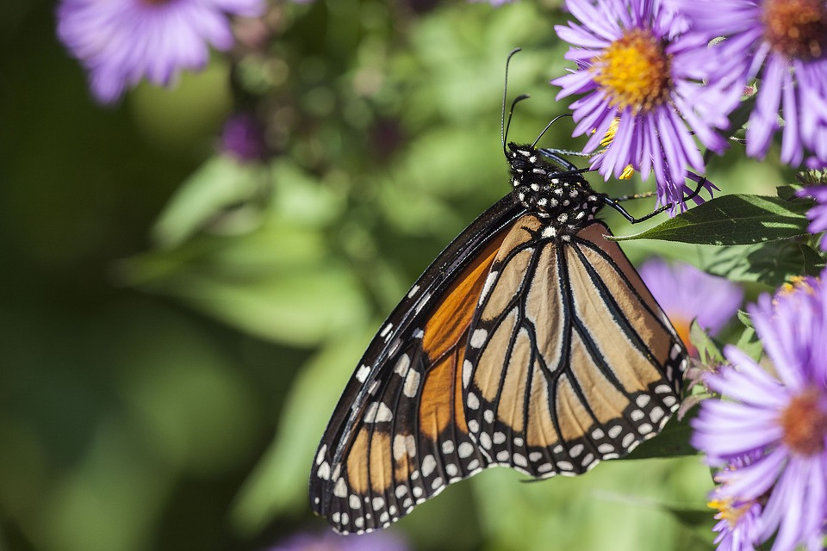
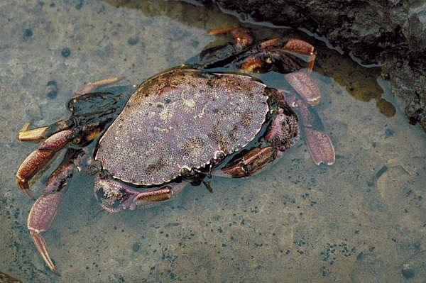
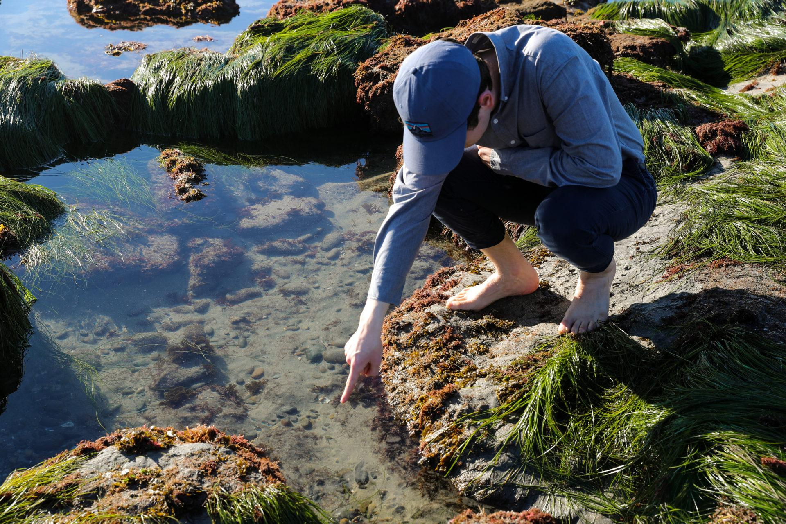
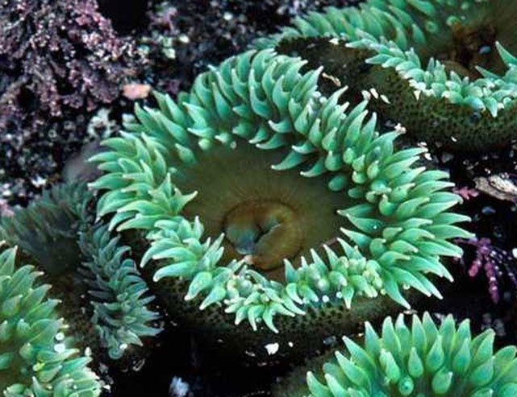
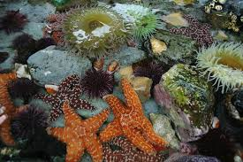
TIDEPOOLS
Natural Bridges SP, Santa Cruz
Notes:
If the tide is low, we may get to go tide-pooling! This is where the students are free to explore within the boundaries and share their discoveries with their naturalists and classmates. One way that you can make ensure that your child is prepared is to make sure that they bring a pair of tidepool shoes. These shoes should be close-toed with good tread so that their feet are protected while they navigate the slippery rocks in the tidepools. Good examples include rain boots, sneakers, or water shoes. Please note that they will want an extra pair of shoes specifically for the tidepools because they might get wet.
Natural Bridges is also a location where Monarch Butterflies gather between November and February. Students may have the opportunity to visit the Monarch grove and see the butterflies enjoying the cover and food from the Eucalyptus trees.

Slide 30
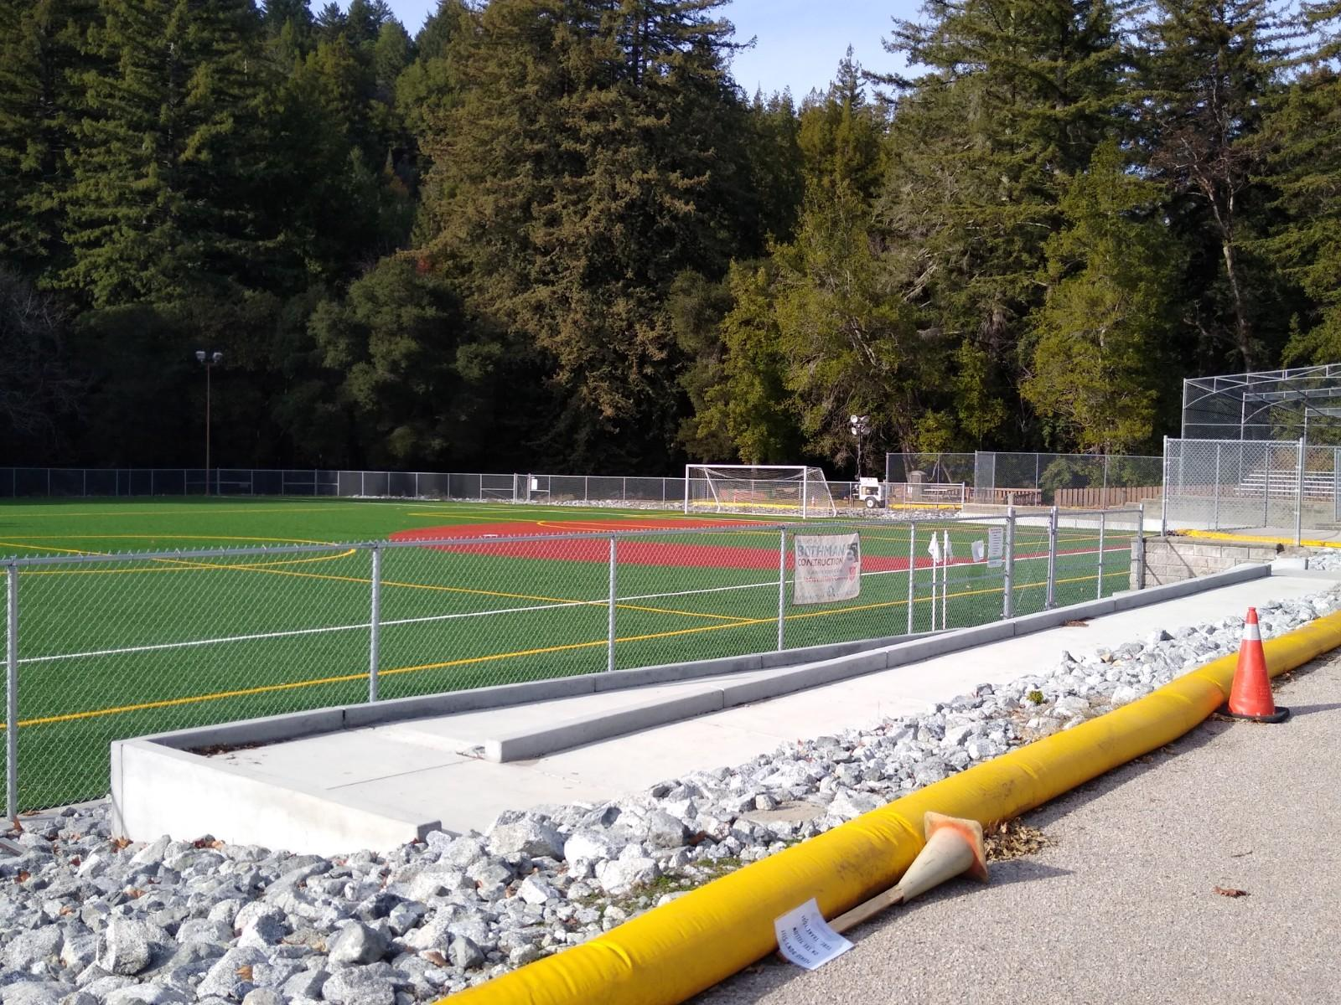
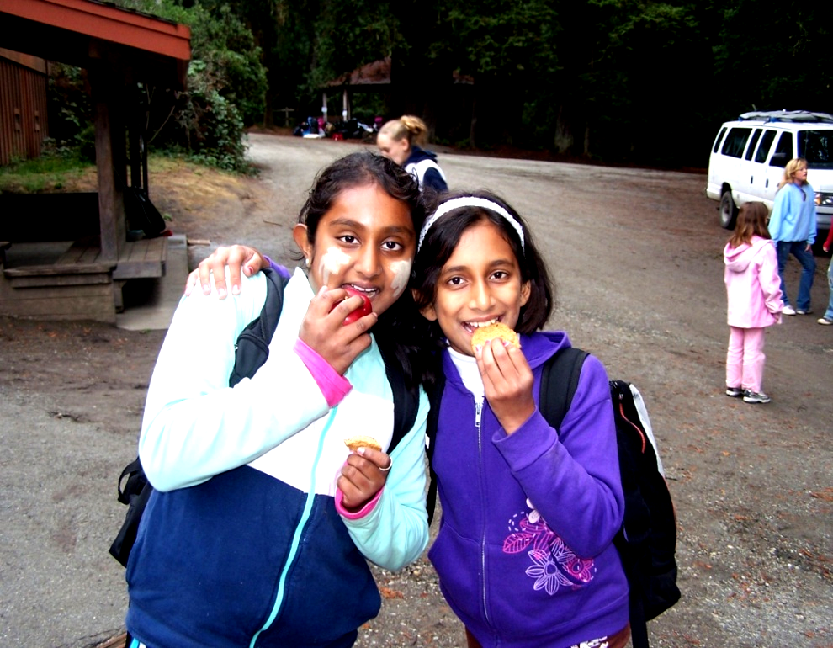
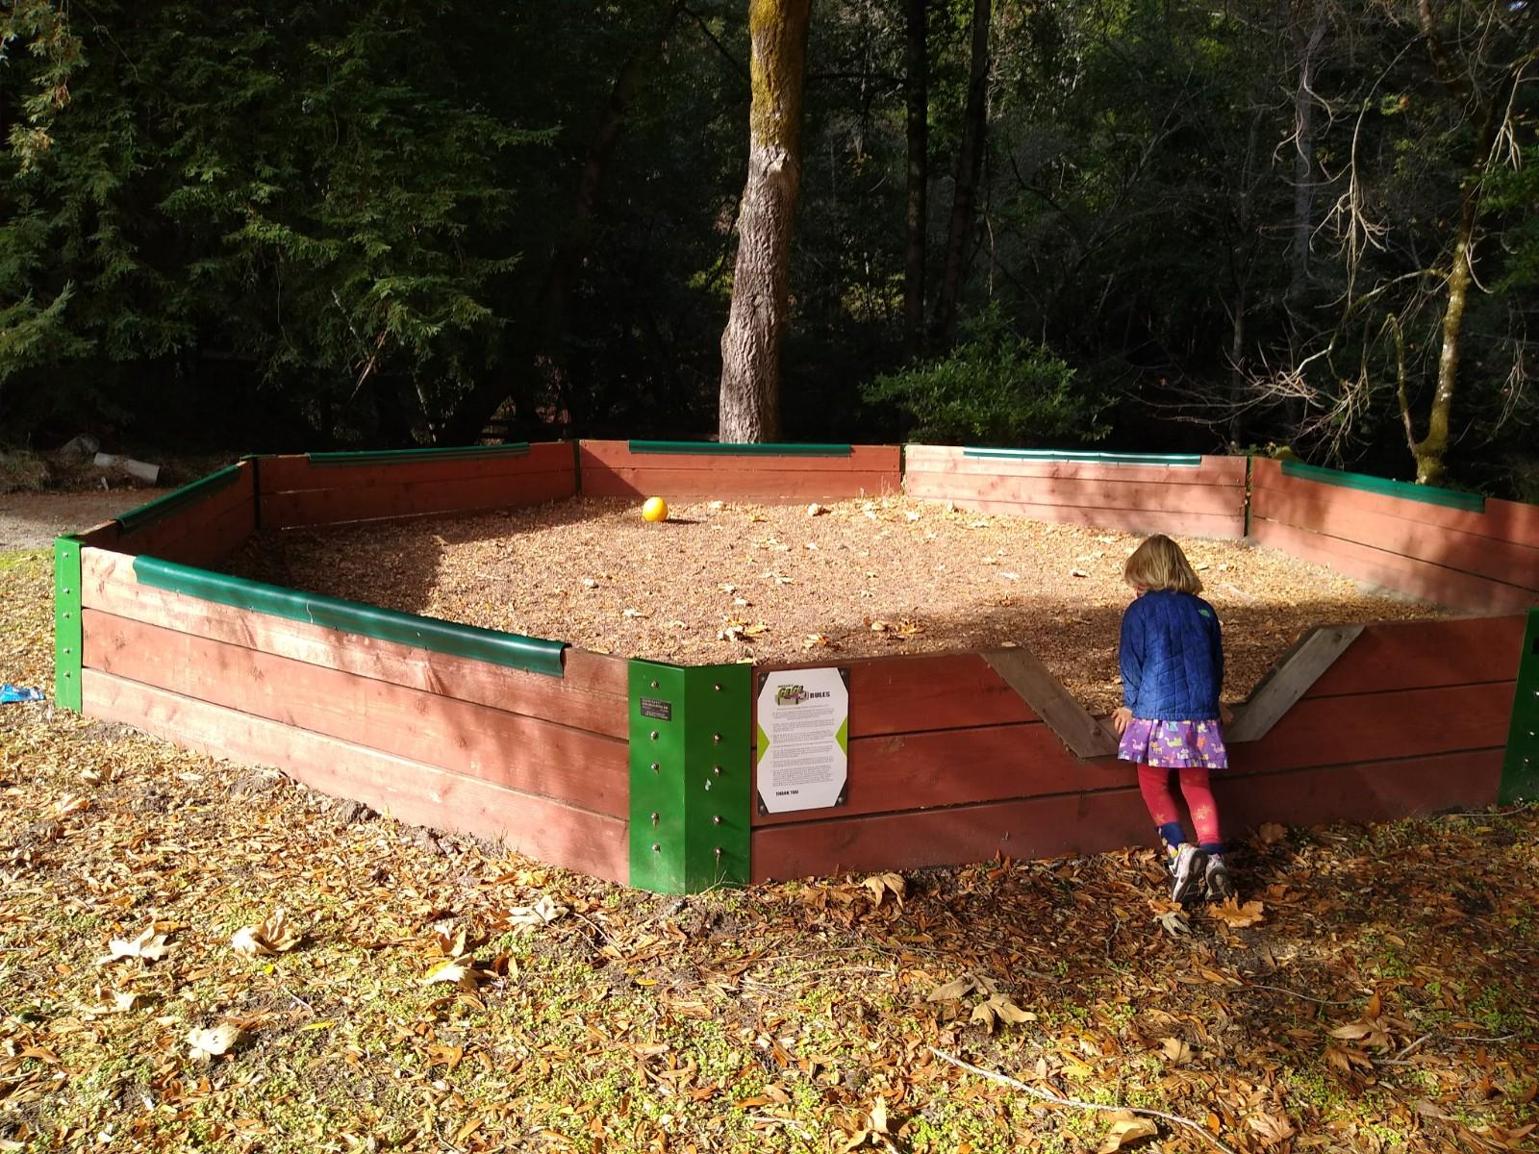
Recreation
Time!
SNACKS!
SPORTS!
Notes:
We offer some recreation time at Sempervirens where they can choose what activity they want to do. This is free time for the whole camp, so your student can hang out with friends not in their cabins or trail groups, play sports on the field, on the basketball court, a gaga pit, or on the volleyball court. Or they can eat a snack, borrow an instrument from our office, or check out a book from our library

Slide 31
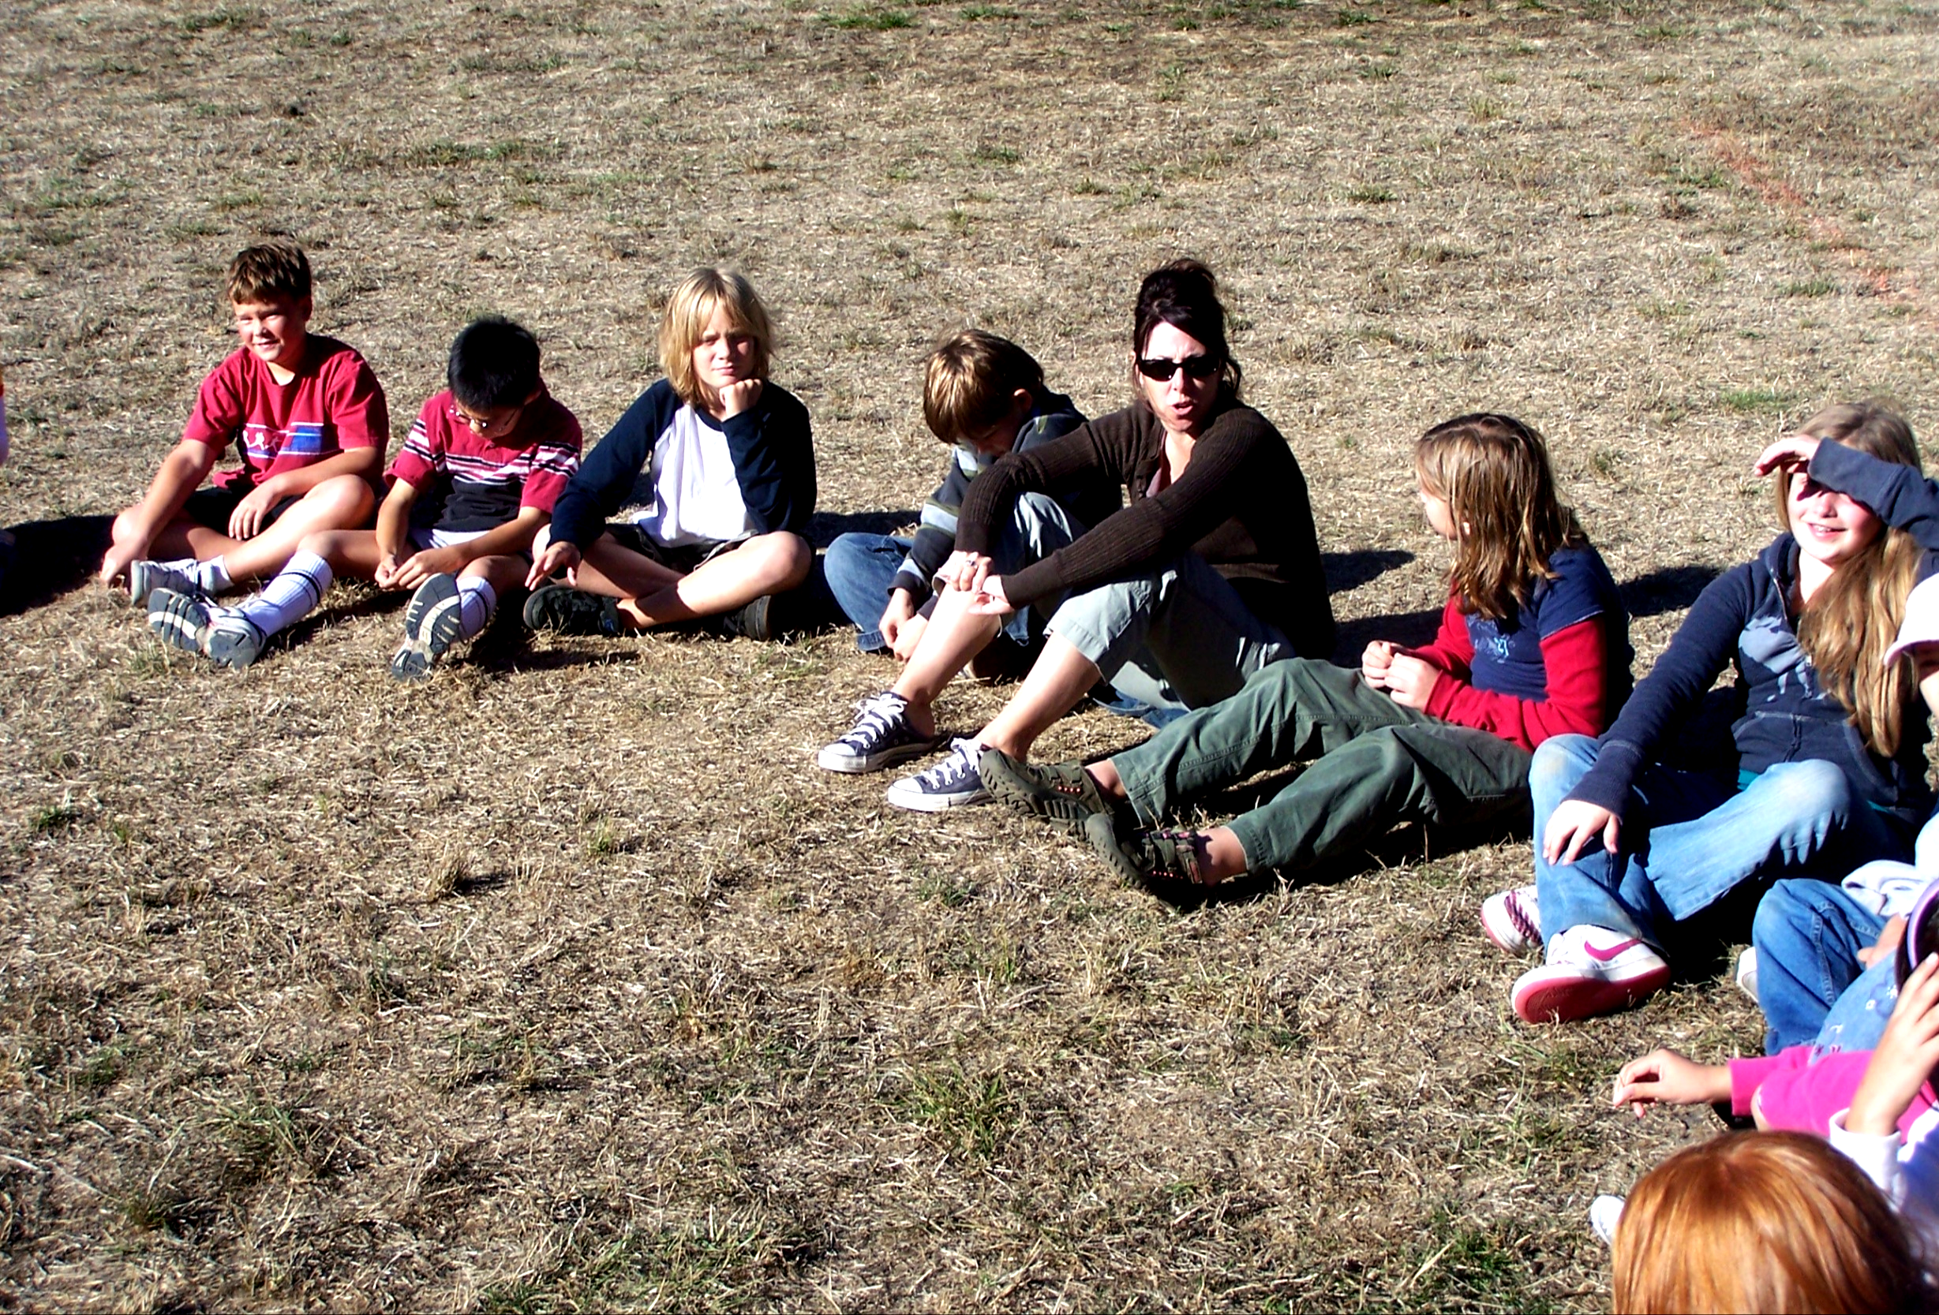
Teacher Time!
Notes:
Teacher time is only on the full days. So not arrival or departure day. Your student will have some time with their classroom and teacher. They will hear about what other people in their class have been up to, since everyone does different things each day.

Slide 32
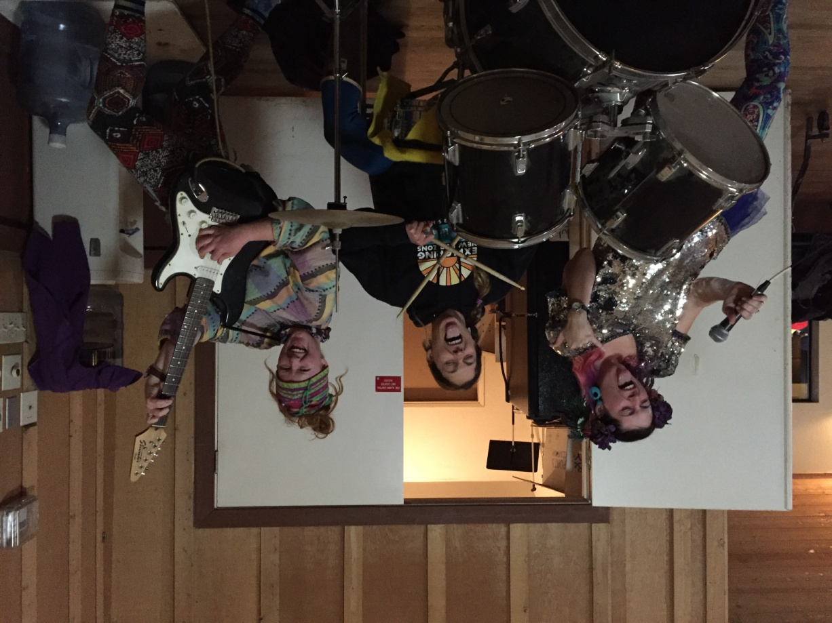
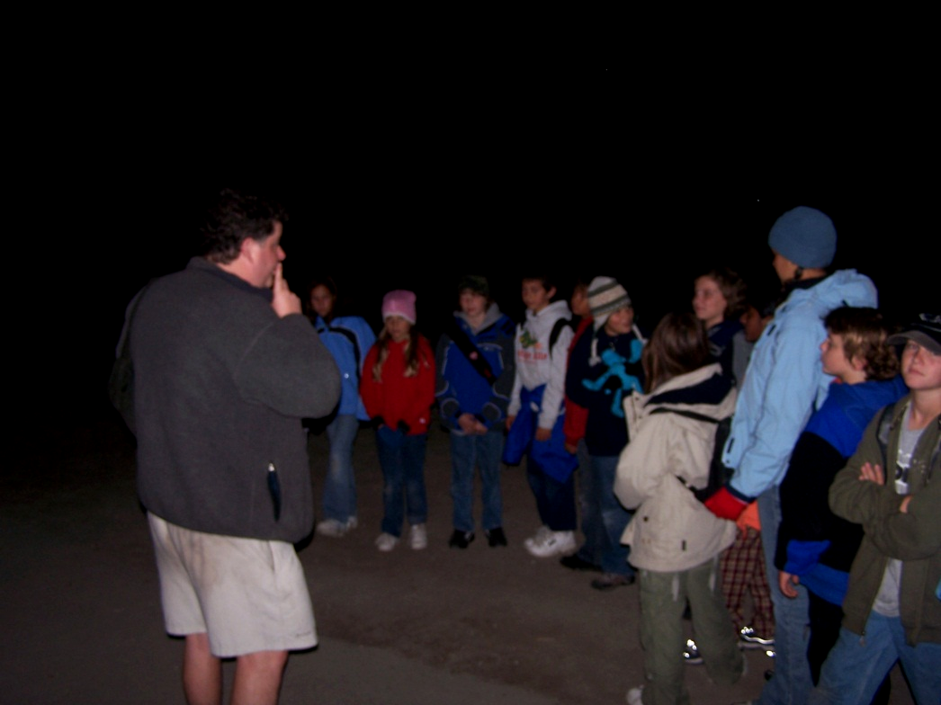
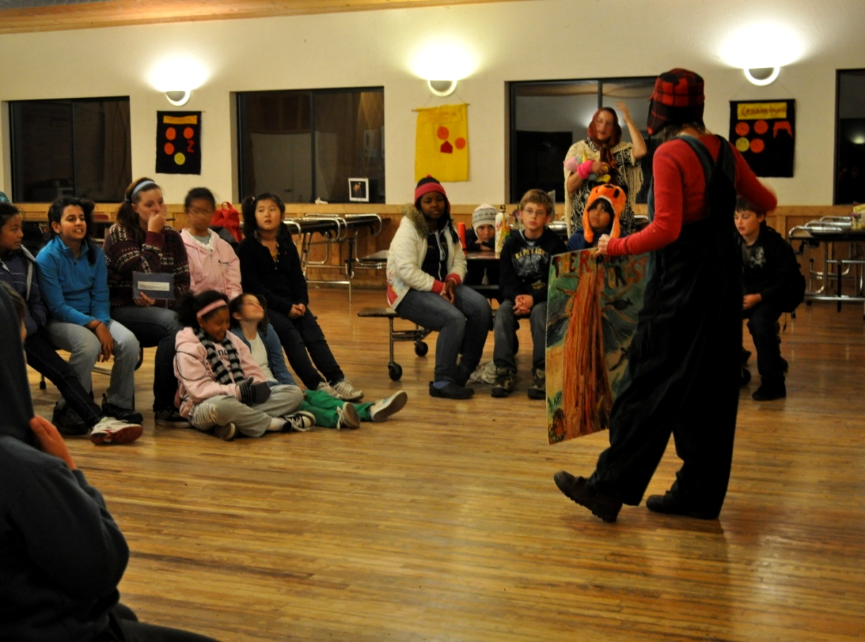
★Evening Activities★
Notes:
After dinner and clean up we come together for some evening activities. Each class will have a Night Hike Town Hall, Skit Night, or Camp Fire/Barnyard Boogie!

Slide 33
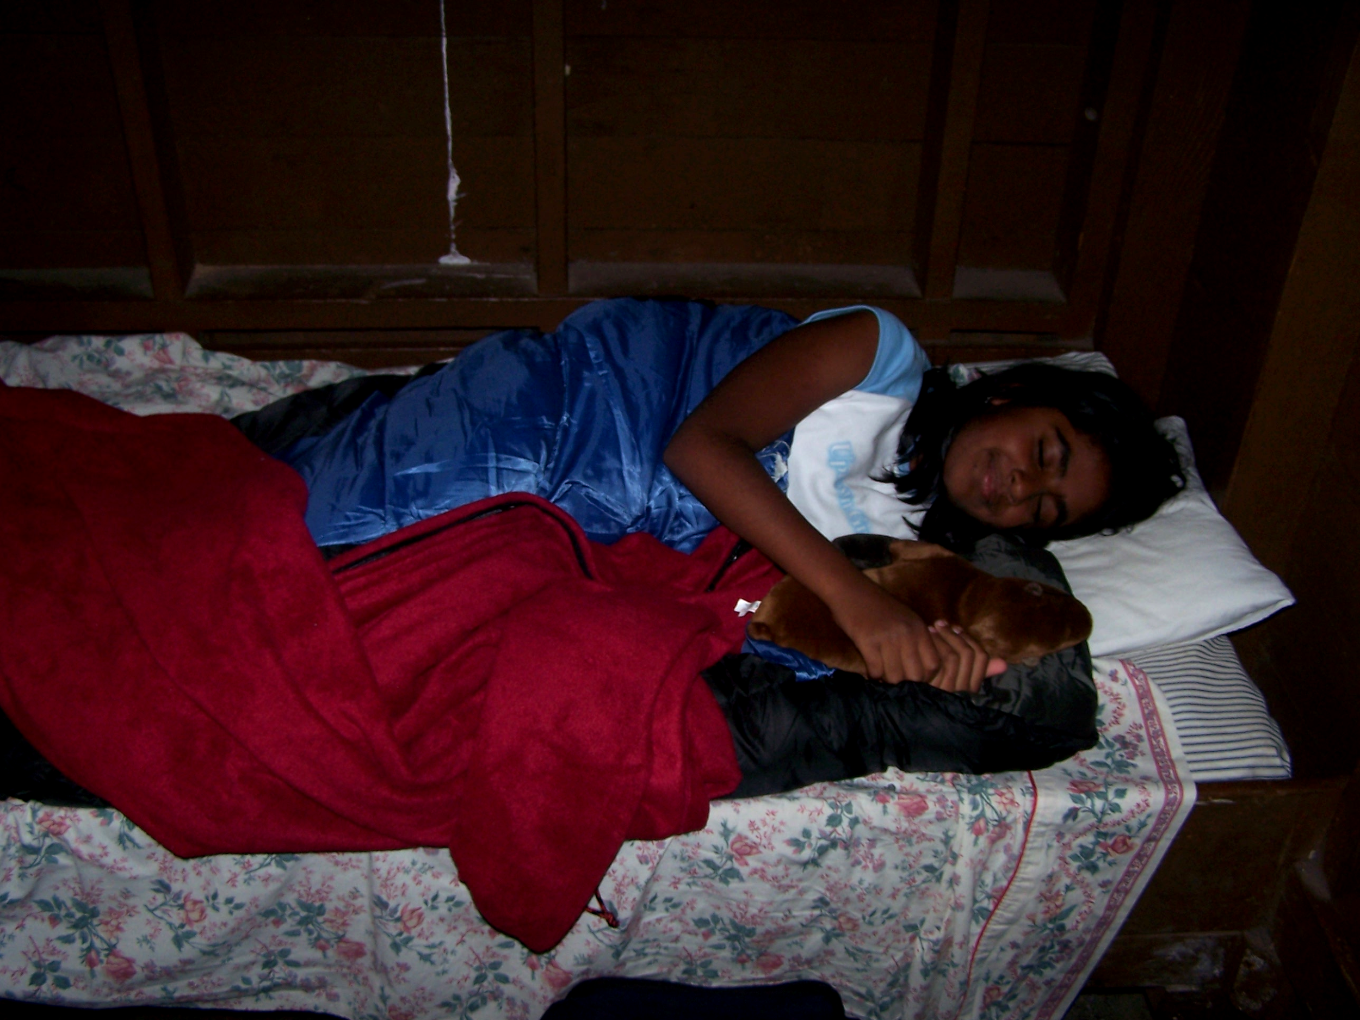
Lights Out at 9:30
Z
Z
Z
Z
Sweet Dreams!
Notes:
And then it is time for bed. Students will have enough time to wash their faces, brush their teeth and change into their pajamas before going to bed. They will bring their own blankets or sleeping bag to keep them cozy at night. Lights out for students is at 9:30, some groups might choose to go to bed earlier. After lights out, all students are expected to be quiet in their beds going to sleep. As mentioned there will be a cabin leader in each cabin. They will be in charge of bed time. Exploring New Horizons staff will be on-call on site in case of any nighttime questions or emergencies.

Slide 34
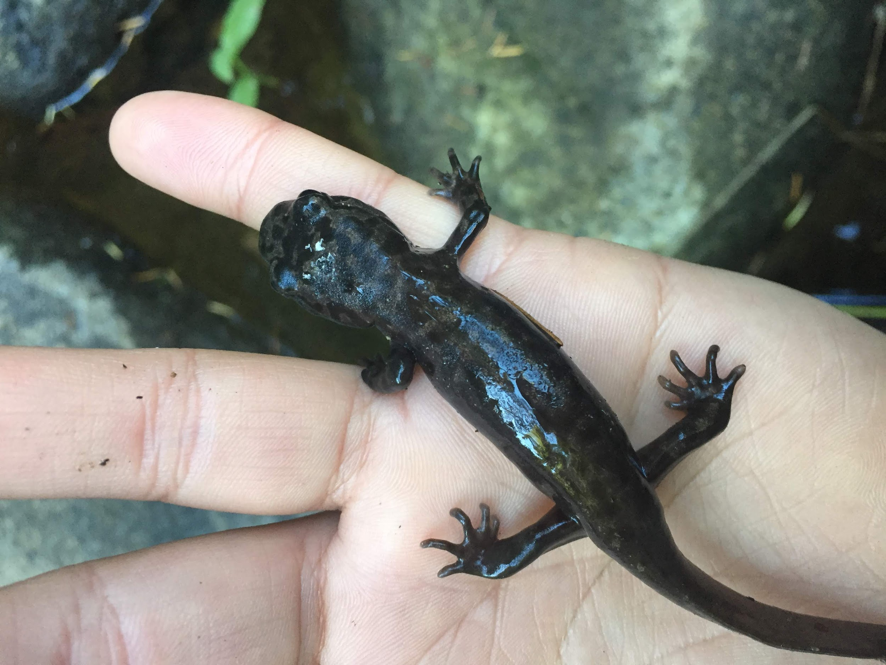
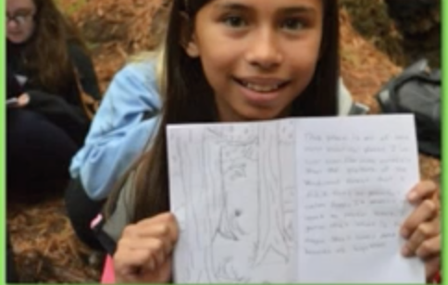
First time away from home?
Sleepovers before camp
Favorite stuffed animal
Journal to write in
Book to read
Missing home is OKAY
Stay busy and engaged
Write letter home
Help from buddies, counselors, teachers, staff
Notes:
If this is your child’s first time away from home, we encourage sleepovers before Outdoor School to prepare them for the experience. They can bring a stuffed animal, journal, or favorite book for comfort. Missing home is normal and may happen, but their schedule is busy and we keep them engaged. We won’t necessarily call the home if the child is homesick right away, they usually work through it. They will not be able to make or receive phone calls. We will call the home if your child is sick or something is wrong, but NO NEWS IS GOOD NEWS!

Slide 35
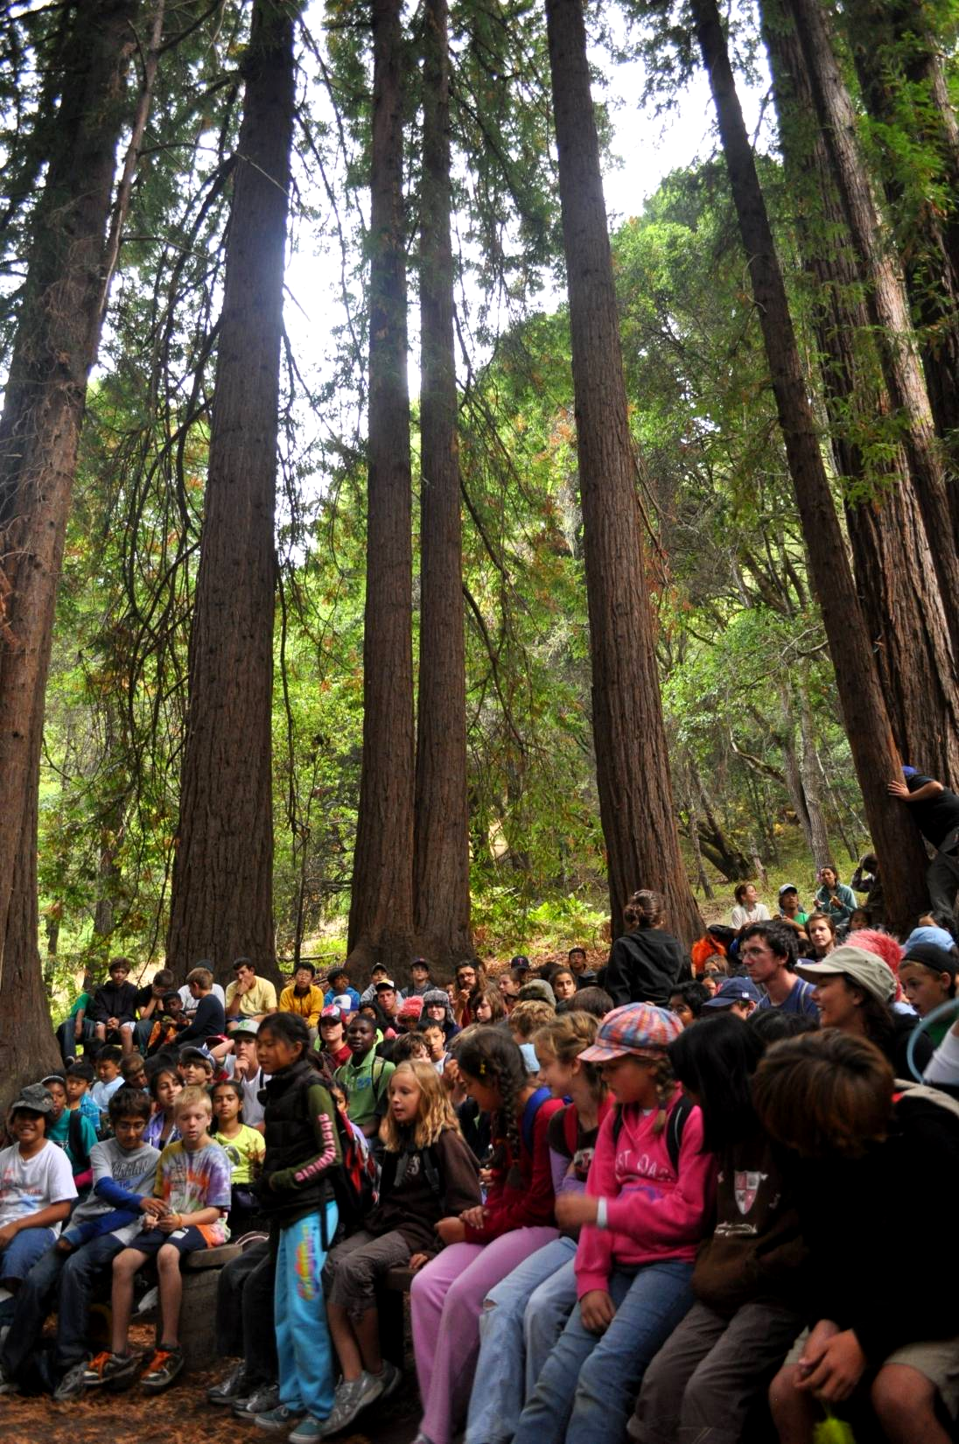
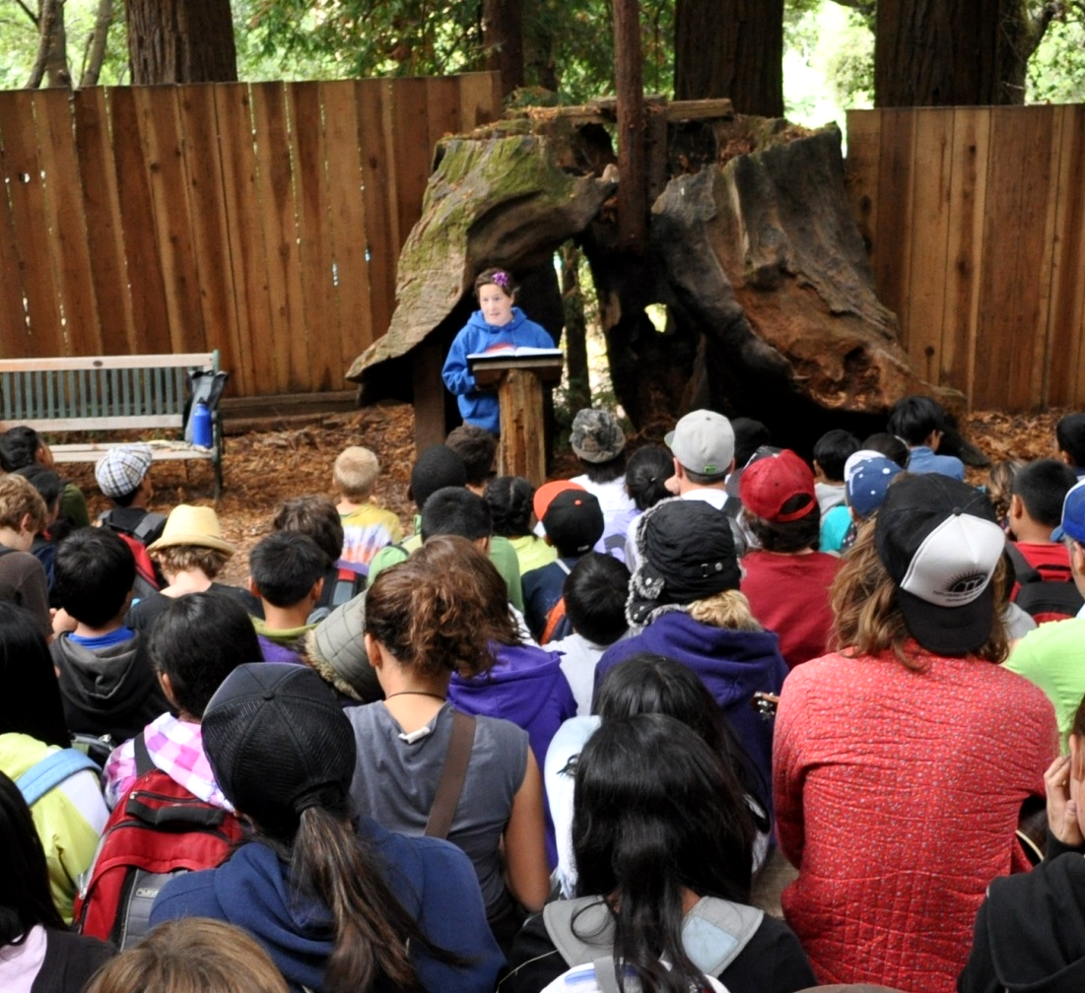
Graduate from
Outdoor School
Notes:
Then on the last day, the students participate in a graduation ceremony for the naturalists to honor your students for all the new things they have tried and new friends they've made. Our naturalists will perform something unique for the group, and some students will get to share about their own experience as well.

Slide 36
Scotts Valley Contact Sheet
Program Director: Danny ‘Dingo’ Beutler
Email: daniel@exploringnewhorizons.org
Phone: 831-252-7868
exploringnewhorizons.org
Notes:
Here is the contact sheet for anyone that you would like to get in touch with regarding your child's needs!

